Slide 1
Helping everyone take part in Census 2021
Ruth Dyble - Census Engagement Manager

Slide 2
Census Day
21st March 2021
England & Wales a ‘Digital First’

Slide 3
Questions are designed to get a wide range of best information
There are questions about age, ethnicity, education, work, health & housing
2021 has a new question about previous armed forces service
There are voluntary questions for over 16’s around gender identity and sexual orientation

Slide 4
What has engagement has happened so far?
LA Departments: media & comms, housing, community safety, electoral services
Adult social care and supported housing providers,
Stronger Communities Teams and their networks
Libraries & CAB
Military,
Health Watch, Citizen Online
Gypsy & Traveller groups
And lots more!

Slide 5
Census timeline
Census Day
21 March 2021
Every household receives a postcard telling them the census is coming
Mass marketing campaign begins on TV, radio, newspaper, in schools and more
Last day to complete your questionnaire online
4 May 2021
The contact centre and support centres go live
CEMs and CAs continue working closely with their communities and local authorities
Every household receives a pack telling them to join in now – and how to do it
Reminder letters start arriving and field officers visit houses still to respond
Online help centre goes live
23rd Feb 2021
Census Coverage Survey begins
January
February
March
April
May

Slide 6
What help is Available?
website Census 2021 or phone line
New/Replacement Codes
Paper questionnaires
Individual questionnaires
Full completion over the phone
Large Print
Braille Booklet
Language Translations
Easy Read Booklet
Text Relay
BSL Videos’ - online
Separate language helpline

Slide 7
Field Team Follow Up
They will be only visiting properties that haven’t completed
Officers will be visible and carrying ID
They will have PPE - hand gel used between each visit
Posting peg used to hand over forms
Social distancing maintained
Never ask to enter property
Never ask for payment

Slide 8
Additional Information
website:
Downloadable posters, leaflets, social media content
Videos of the how the field team will work safely- via the jobs page: Census 2021 Jobs
More information about data security

Slide 9
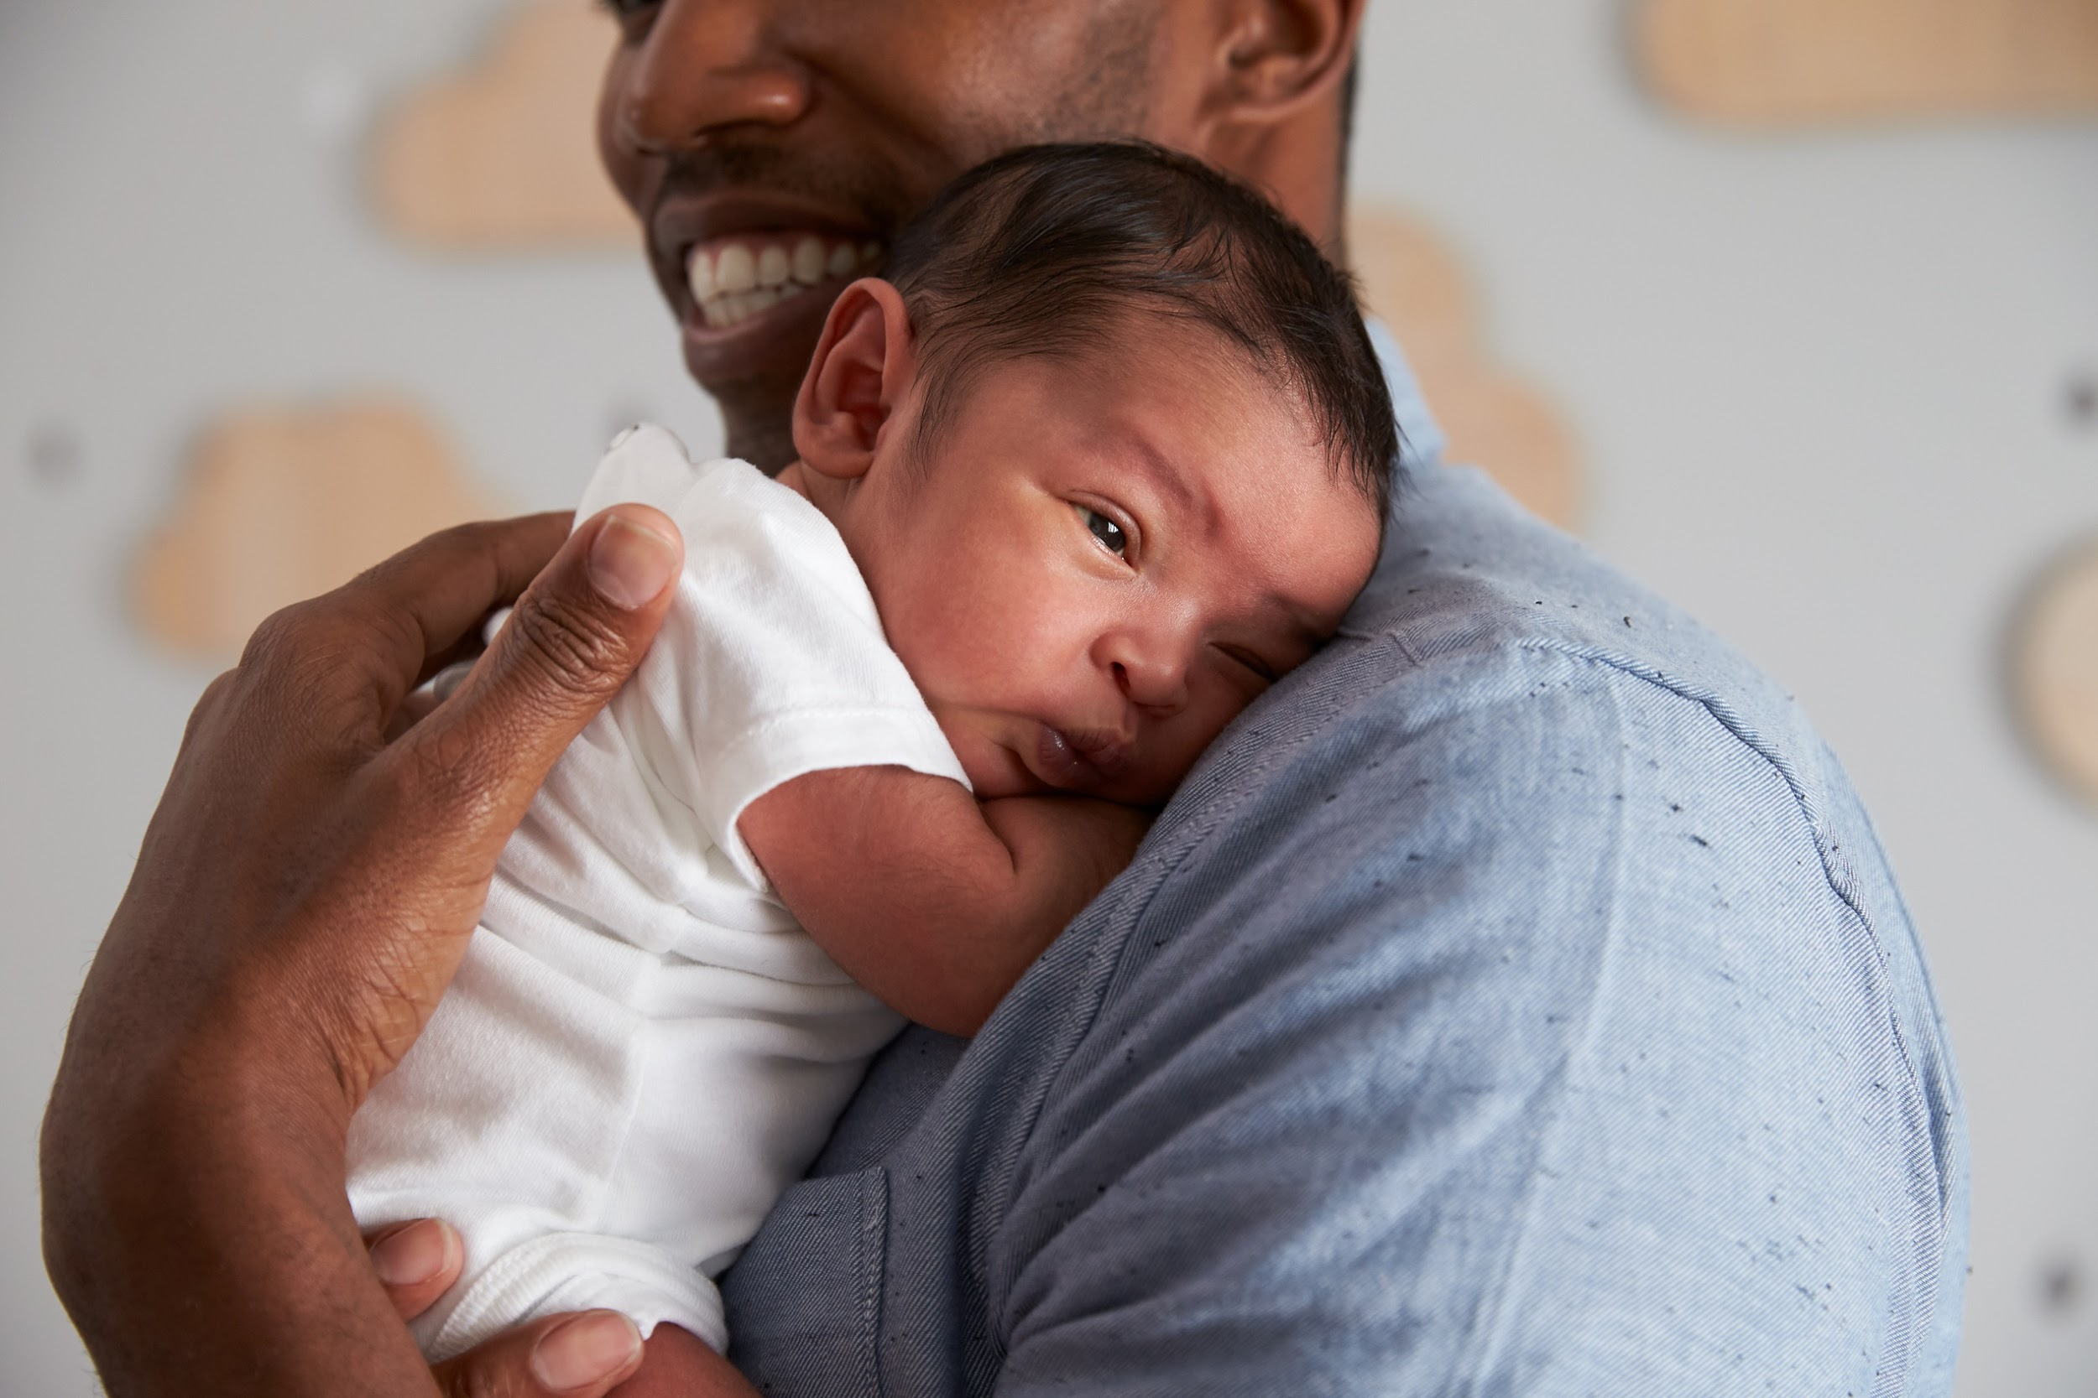
On Census Day in 2011, 1,586 babies were born in England and Wales…
…and 176,632 people identified as Jedi!
(This was down from 390,127 in 2001)
…6,242 people put their religion as 'Heavy Metal’…

Slide 10
Next Steps
Talk to your local Census Engagement Manager (CEM) about the ways to help your community join in.
ruth.dyble66@census.gov.uk
07452 942849
For more information on the census visit www.census.gov.uk
Follow the census on Twitter, Instagram and Facebook @Census2021 @Cyfrifiad2021

