Slide 1

What is an Integrated Care Community?
‘Integrated Care Communities are integrated teams of health and care workers, voluntary organisations and wider community assets who work together to practice population health with a mobilised population’
It is a way of working – not a defined entity
Staff are directly employed in General Practice and UHMB to work in ICCs but do not run a traditional clinical service – ‘organisationally agnostic’
Other non-directly employed staff and services add to ICC capacity
There are currently six in South Cumbria – 5 are coterminous with PCNs
ICC received 376 referrals a month – 4,500 in a year

Slide 2
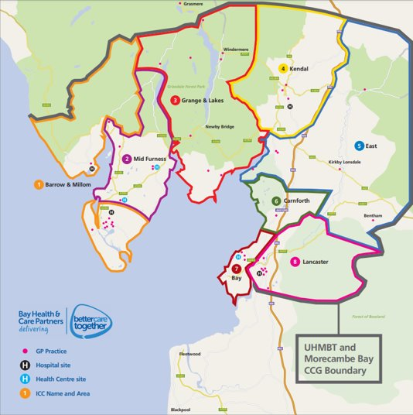
What is an Integrated Care Community?

Slide 3
Emerging Operating Model

Slide 4
Neighbourhood
Focus on Individual
Core Offer
Acute and Community Mental Health
Focus on Community
Local Variation
Integrated Car
Integrated Neighbourhood Teams
Acute and Community Physical Health
Thriving Communities
LA
MDT
PHM
Risk Stratification
Care Navigators
Social Prescribing
HAWCS
Discharge
Admission Avoidance
Integrated Care Communities
Asset Based Community Development
Public Health
Community Mobilisation
PCNs
VCFSE
Other Primary Care

Slide 5
The Population Health Management Hexagon
Integrated Care Communities (ICCs) use a Population Health frame of reference look to influence these six elements seeking to achieve through their work with partners at a community level.
PREDICT Using data, insight and ongoing dialogue with communities to identify early issues likely to lead to ill health
RECOVER Working with people and carers to enable those recovering from illness to live as full a life as possible, or receive excellent and equitable palliative care
PREVENT Acting with people and communities to improve lifestyles, social circumstances and our environment to improve health and wellbeing
MANAGE Ensuring equitable access to the best possible healthcare at the earliest opportunity
DETECT working proactively in integrated teams to find people who have a condition which increases their risk of ill health
PROTECT Working with people with known conditions/risk factors to reduce their risk of ill health

Slide 6
Key Functions

Slide 7

ICC Operating Model
This is how the Integrated Care Communities (ICCs) deliver with partners at a community level.
The work plan of the ICCs can be summarised into 8 key domains of work.
Each domain work includes a combination of routine activities and localised actions that reflect the needs of their communities.
Each domain of work requires different skills sets and resources and will generate different benefits and outcomes.
ICC Activities
Convening Partners
Engagement and Intelligence
Collaborative Project Work
Proactive Case Finding
MDTs
Targeted Interventions
Emergency Response
Care Co-ordination

Slide 8
Convening of Partners
Brining partners together around a specific issue or topic that is affecting the community.
Regular and intentional
Outputs of this work include:
Networking,
Updating
Strengthening relationships
Collaboration e.g. making funding buds
Cross referencing information
Support
Building and maintaining trust
ICC Activities
Convening Partners
Engagement and Intelligence
Collaborative Project Work
Proactive Case Finding
MDT Review
Care Coordination
Targeted Interventions
Emergency Response

Slide 9
Engagement and Intelligence
Engaging with communities to understand the barriers affecting their health and wellbeing.
Working with partners to understand the issues and challenges to a community, ward, street and family level.
Supporting PCNs to understand their health inequality issues and to prioritise action within member practices.
Outputs of this work include:
Identifing populations who are poorly served
Informs a population health approach
Enables development of targeted approaches and short tests of change
Delivering some of the priorities in the Joint Local Health & Wellbeing Strategy
is informs us of gaps in provision and enables us to develop a Population Health approach which has the best chance of making the necessary impact.
ICC Activities
Convening Partners
Engagement and Intelligence
Collaborative Project Work
Proactive Case Finding
MDT Review
Care Coordination
Targeted Interventions
Emergency Response

Slide 10
Collaborative Project Work
Providing clinical, administrative and community expertise into local projects hosted by partners such as the local authority and VCFSE
Providing a route for partners to engage with primary care within specific communities.
Outputs of this work include:
Strengthening partnerships
Sharing knowledge and expertise.
Delivery of Individual project objectives and outcomes
Example – ‘Clear, Hold, Build’ initiative via WaF Constabulary, Kent Estuary Youth (KEY)
ICC Activities
Convening Partners
Engagement and Intelligence
Collaborative Project Work
Proactive Case Finding
MDT Review
Care Coordination
Targeted Interventions
Emergency Response

Slide 11
Proactive Case Finding
Using data and local intelligence to risk stratify and proactively outreach into communities.
Identifying unmet health need using clinical & social data and through partnership working with VFSE partners.
Outputs of this work include:
Use data and other sources to pro-actively find individuals who may be at risk of declining health and ability.
Offer assessment and interventions to enable people to stay well e.g.
  Undetected hypertension
  Increased referrals to cancer screening services
  Onward referrals
Offer assessment and interventions to enable independent for longer
Generate a care plan that can be shared – 200 per month
ICC Activities
Convening Partners
Engagement and Intelligence
Collaborative Project Work
Proactive Case Finding
MDT Review
Care Coordination
Targeted Interventions
Emergency Response

Slide 12
MDT Review
Individuals in S Cumbria whose situation is complicated have, with their consent, the opportunity for their situation to be considered by a multidisciplinary team. The MDT consists staff from different teams and organisations who draw on the combined knowledge of the group to generate suggestions that may be helpfully employed. Referrals come into MDTs from all partners
Outputs of this work include:
600 people a year supported by virtue of wider discussion.
More robust decision making and management of risk and ambiguity.
Strengthening partnership working
Professional development and system learning.
*Ensure ‘fit’ with Mental Health approach - EMDT and other processes
ICC Activities
Convening Partners
Engagement and Intelligence
Collaborative Project Work
Proactive Case Finding
MDT Review
Care Coordination
Targeted Interventions
Emergency Response

Slide 13
Care Coordination
The ICC provides care coordination to individuals who may not yet be known to the services that could support them or whose situation may be unstable or at risk of deteriorating until such time that a coordinated plan is in place
Outputs of this work include:
Ensuring progress and completion of tasks.
Interventions to maintain independence
Generation of an electronic holistic care plan that can be shared
Positively impact on demand on unscheduled health and health care
Reduction in hand-offs
ICC Activities
Convening Partners
Engagement and Intelligence
Collaborative Project Work
Proactive Case Finding
MDT Review
Care Coordination
Targeted Interventions
Emergency Response

Slide 14
Targeted Interventions
ICCs will use detailed information to identify groups of individuals that may benefit from a bespoke intervention that is currently not available via existing services. They design and deliver these targeted interventions over a time limited period and review, evaluate and report their findings
Outputs of this work include:
Individual project objectives and outcomes
‘Health hearts, healthy minds’ project, Long Covid support group
Culture change and wider frame of reference for NHS staff
ICC Activities
Convening Partners
Engagement and Intelligence
Collaborative Project Work
Proactive Case Finding
MDT Review
Care Coordination
Targeted Interventions
Emergency Response

Slide 15
Incident Response
The Covid pandemic and adverse weather events over recent years has shown the importance of local community knowledge within our incident response.
A key task for ICCs is the early identification of vulnerable residents affected by an incident. This helps in prioritising our response and communication with other agencies.
The ICC can also support the urgent and emergency care system during periods of intense pressure by unblocking discharge issues and coordinating care out of hospital.
Outputs of this work include:
Specific event responses
ICC Activities
Convening Partners
Engagement and Intelligence
Collaborative Project Work
Proactive Case Finding
MDT Review
Care Coordination
Targeted Interventions
Indicent Response

Slide 16
Questions
Does your organisation feel linked into this model of working?
Do the 8 domains represent what you understand?
How could we strengthen the model?
What could Integrated Care Communities do for you?

