Slide 1



Claire Burke
Support Services Manager

Slide 2
Who are we?
Dementia Forward was formed in Ripon in April 2012
We officially gained charity status when we were given our charity
number in July 2012.
We employed North Yorkshire’s first Admiral Nurse in April 2013. We now have our own Dementia Specialist Nurse and are hoping to build a team of them across the county.
In June 2014 Dementia Forward was awarded its first contract spreading our services to York and The Vale
In May 2017, we opened our first Dementia Hub we In April 2019 – we were awarded the contract for the whole of North Yorkshire, and are now the leading dementia charity for the county.
In 2023 we now have 17 Hubs across 8 different venues
Our team has grown to around 70

Slide 3
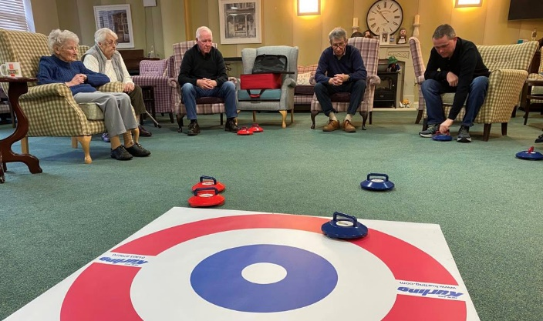
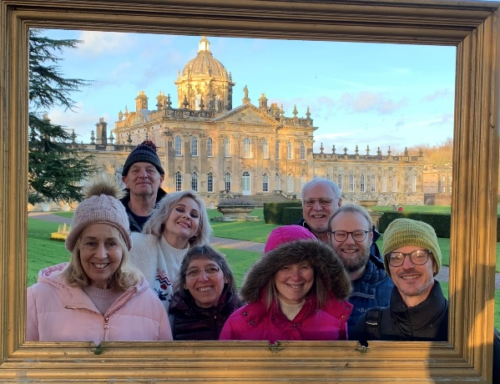
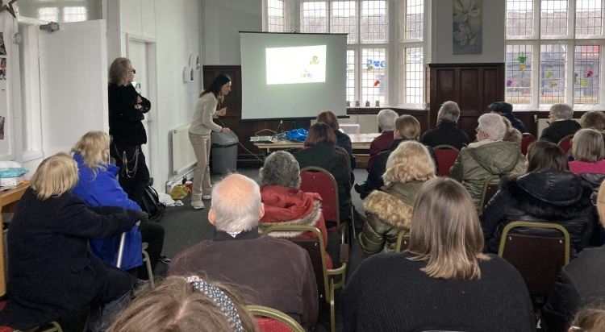
What we do
Dementia Support Advisors
Memory Support Advisors
Dementia Specialist Nurse
Wellbeing Services
Specific Young Onset Service
Training and Awareness
Working in partnership
Helpline: 03300 578592 referrals, support

Slide 4
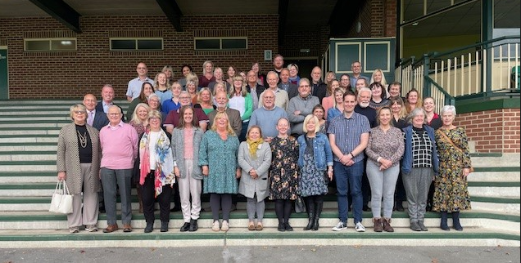
Our People

Slide 5

Hubs and Wellbeing Cafes

Slide 6

Young Onset Services

Slide 7
Dementia Training

Slide 8

Helpline

Slide 9
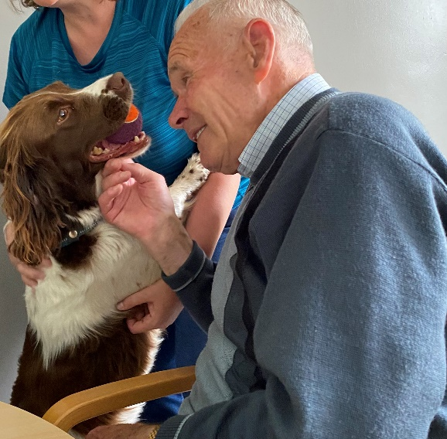
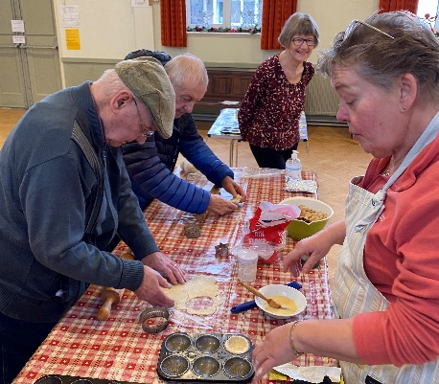
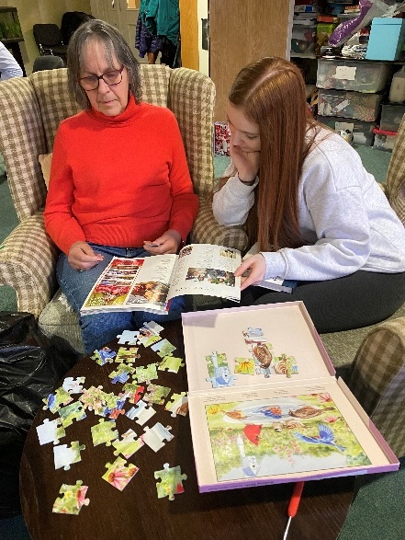
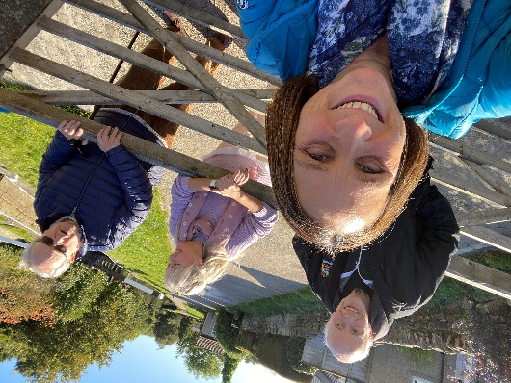
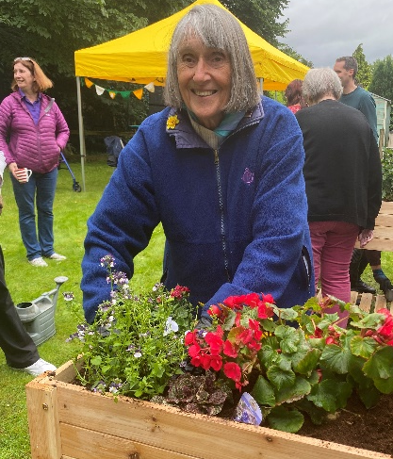
Services in Craven
Wellbeing Café
St Johns Methodist Church Settle - Tuesday 1:30-3:30pm
Three Links Club, Skipton - Wednesday 1:00-3:00pm
Hub Clubs
Neville Crescent Common Room, Gargrave – Tuesday 10:00am – 3:00pm
Limestone View, Settle – Friday 10:00am – 3:00pm
Young Onset Support
Coming soon…

Slide 10
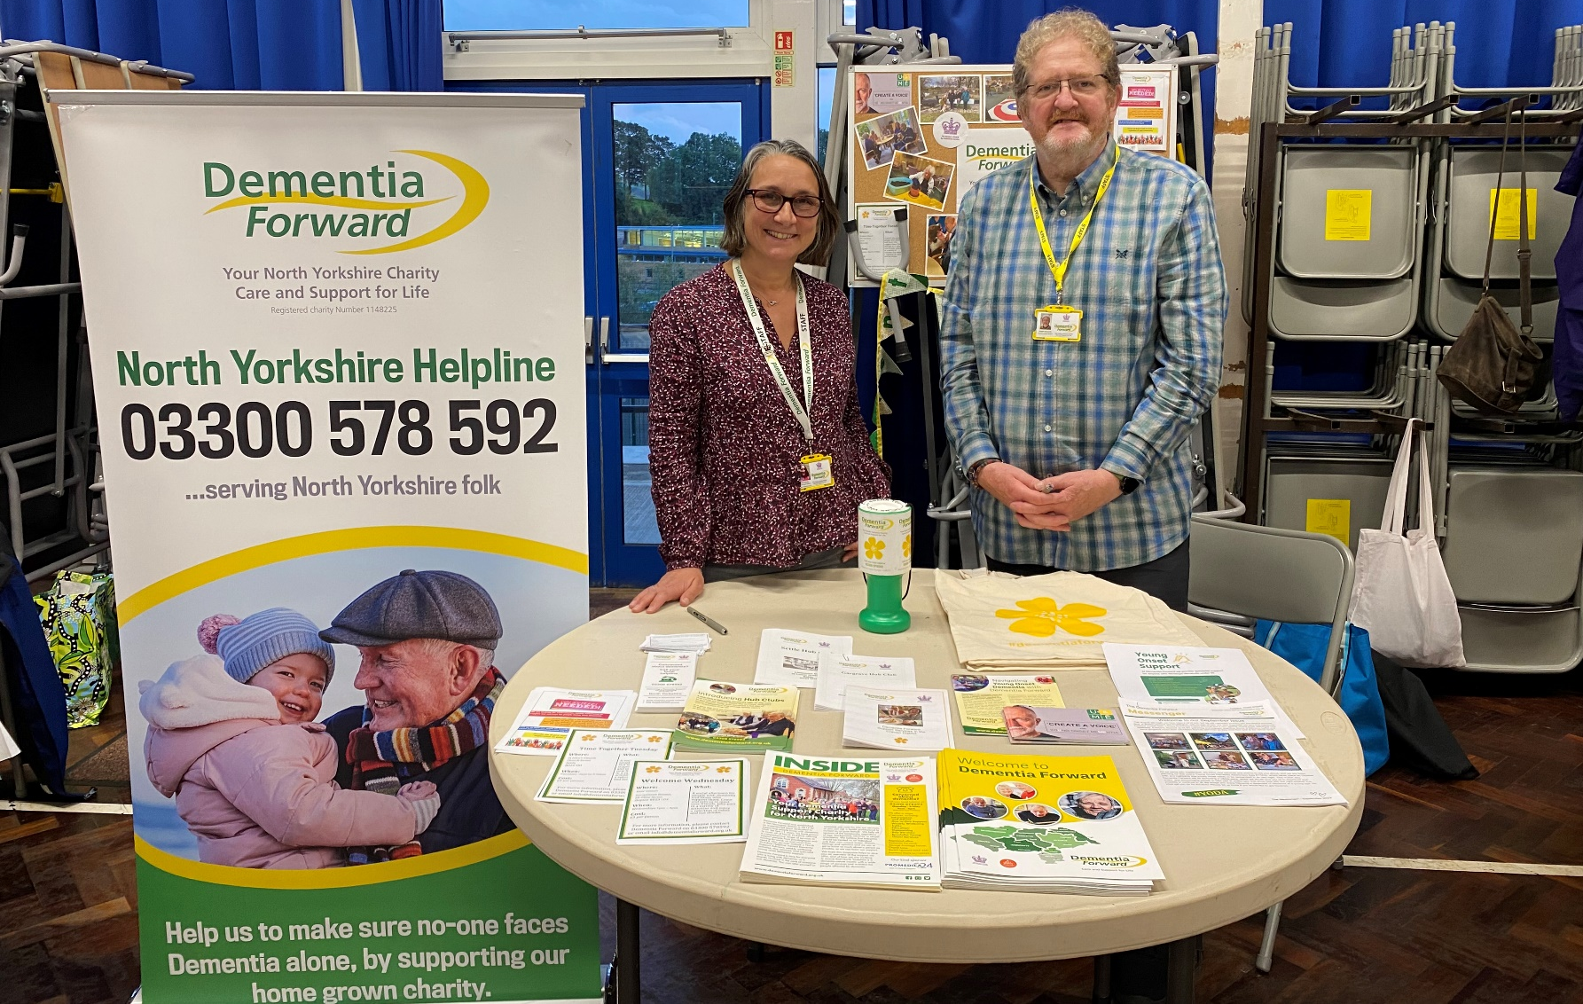
Building Stronger Communities

Slide 11
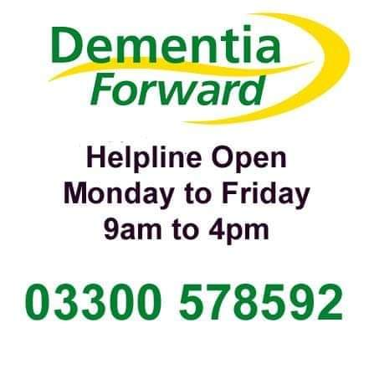
Thank You

