Slide 1



“Bring Me Sunshine” Strategy
Living Well With Dementia

Slide 2
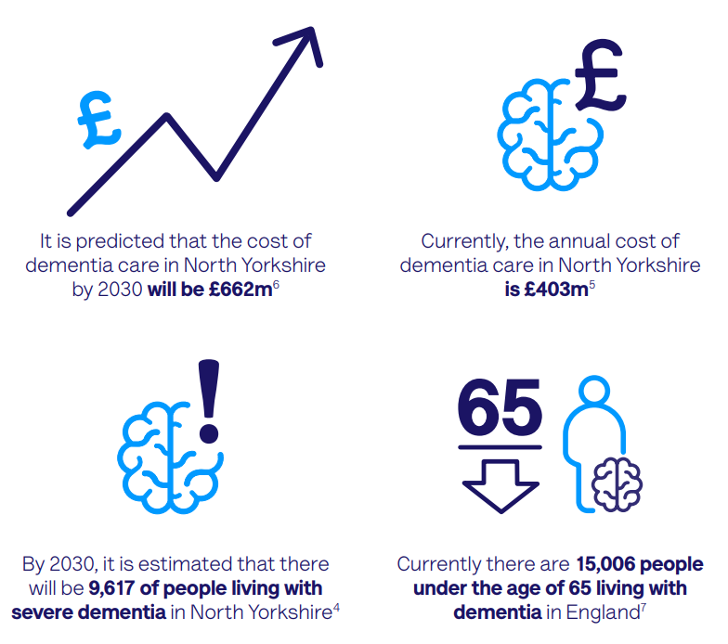
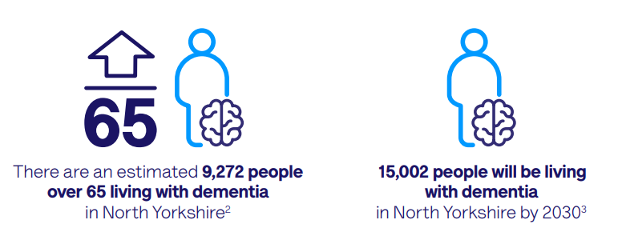
Dementia in North Yorkshire: facts and figures
Source: Local Dementia Profile Dec 21. Alzheimer's Society
Notes:
Higher for women than men
Over half (58 per cent) of UK adults have low confidence in their pensions knowledge, analysis from Phoenix Insights has revealed, with over a quarter (28 per cent) of savers knowing ‘little or nothing’ about pensions, while just one in 10 (11 per cent) report a ‘good’ knowledge. men were 1.4 times more likely than women to report good pensions knowledge.
Over half (58 per cent) of UK adults have low confidence in their pensions knowledge, analysis from Phoenix Insights has revealed, with over a quarter (28 per cent) of savers knowing ‘little or nothing’ about pensions, while just one in 10 (11 per cent) report a ‘good’ knowledge.

Slide 3
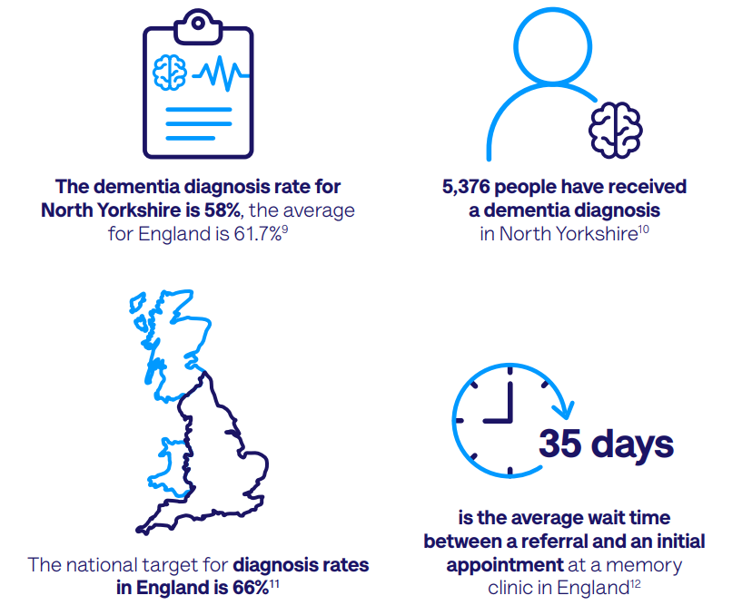
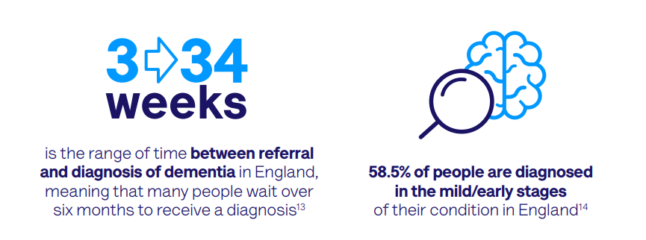
Facts and figures cont.
Source: Local Dementia Profile Dec 21. Alzheimer's Society

Slide 4
Background
“Bring Me Sunshine” Living Well With Dementia in North Yorkshire Strategy launched in 2017
Health, Social Care, Voluntary Organisations – one voice aspiring to make North Yorkshire a place where people can live well with dementia
Strategy built on personal feedback – 1300 North Yorkshire residents
Shaping future direction of services and support

Slide 5
Principles & Priorities
The small things
Small acts of understanding can make a huge difference
Carers Matter
Treat them as well as they treat us
4 Principles
I am me
I am not Dementia
I have a name and I expect it to be used
Consistency
Where I live shouldn’t determine how I am treated

Slide 6
Principles & Priorities
5 Priorities
Dementia Friendly North Yorkshire
Workforce Development
Diagnosis
Support & Advice
Planning for the Future and Dying Well
We will ….
We will ….
We will …
We will ….
We will ….
Outcomes
Outcomes
Outcomes
Outcomes
Outcomes

Slide 7
Feedback from engagement
Priorities are all still relevant – considering adding an additional one around accommodation
Positive feedback about breadth of support available but capacity is an issue due to increased demand
Concerns about delays in diagnosis – further work to do
Develop stronger links with primary care
Increasing numbers of young onset – support needs are different
There is a need to reinstate the dementia action groups/alliances to drive work forward in each area and at a county level
Need for further training including specialist training
Continue to roll out dementia friendly training
Need to explore potential to establish brain cafes

Slide 8
Next steps
Share findings of engagement inviting further comments
Please let us know about any issues/gaps/priorities dementia@northyorks.gov.uk
Update and launch refreshed strategy
Reinstate dementia groups where they are not running to implement the strategy
Awaiting major conditions final strategy (includes dementia)

Slide 9
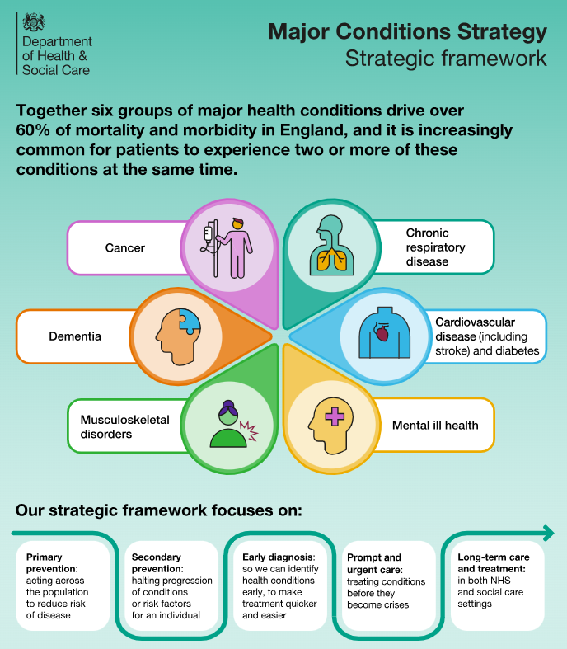
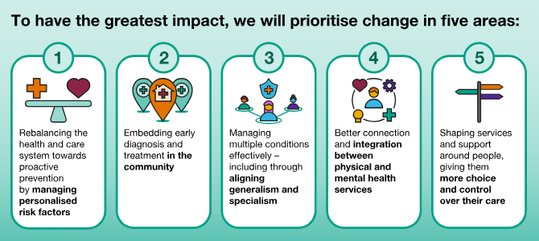
National Major Conditions Strategy

