Slide 1





Warm & Well in North Yorkshire
Mark Boyer
Energy Team Leader
Notes:
Introduce myself.
Energy Team as part of North Yorkshire Citizens Advice and Law centre
The project is part of a partnership of organisations and charities across all areas of North Yorkshire and we work together to alleviate fuel poverty and support communities to stay well

Slide 2
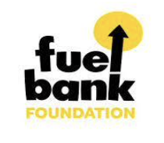






Energy Industry Voluntary Redress Scheme
Notes:
The service was set up in 2017 with funding from North Yorkshire County Council (now just North Yorkshire Council) to prevent excess winter deaths. Over the last ⅚ years the project has received funding from a number of other partners. This has allowed us to expand the team to support more clients as well as some pots of funding being available to provide practical or financial support to clients in vulnerable and urgent situations. You can now see the larger numbers of partners who support us.

Slide 3


The Service:
8 Offices
across North Yorkshire spanning 8,608 km²
19 Advisers
Notes:
Largest County in the country - this means that we have a real range of clients and areas within our locality. From Scarborough with a lot of poor housing stock and high rates of fuel poverty, to Harrogate with high housing costs, to Ryedale with a lot of off-gas clients and rural poverty as well as the 4 other former council areas.
Spread across the various offices to meet clients. As well as admin staff and Gillian who is the project manager.

Slide 4
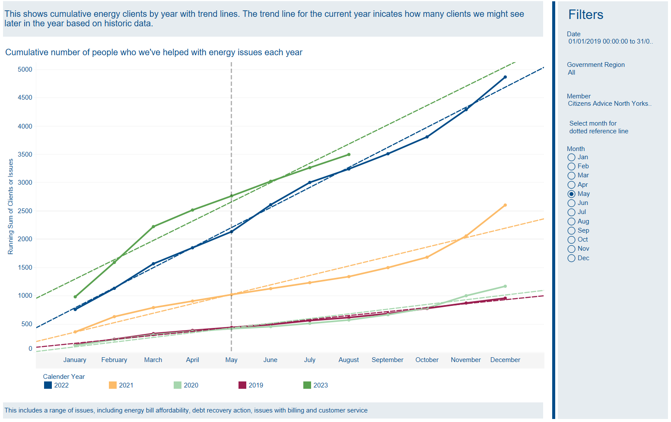
Growth of the service:
Notes:
From 1st September this year numbers went up in a heatwave - reinforces belief that most will struggle as arrears have grown

Slide 5
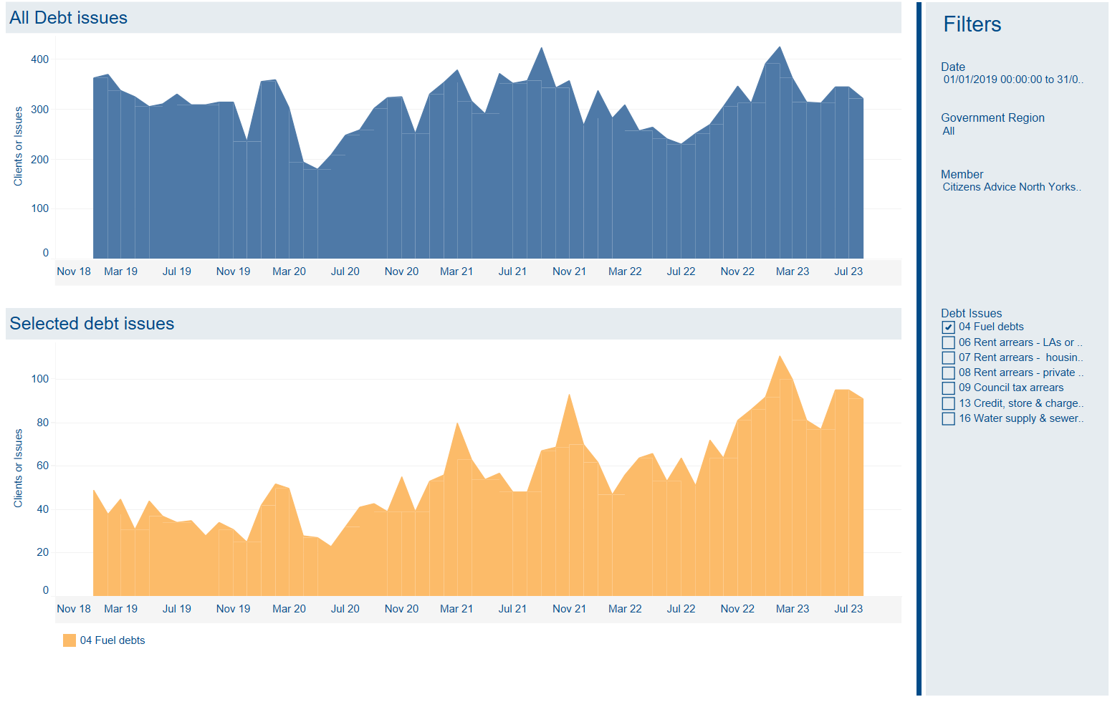
Notes:
Winter different to last year. Lots of demand for our service for debt - seeing more people with fuel debts. Moved from credit/mortgage. Now for household bills and seeing those coming in fuel debt.
Cit A National team 1 in 4 - 27% of pop behind on at least 1 bill -
about a 75% increase in fuel debt. High bills lead to high debt.

Slide 6
Clients

Slide 7




Delivery:
Outreach
Phone
Email
Events
Drop in at our offices
Notes:
We work with a range of partner organisations to reach as many people as possible – a key access channel is the Single Point of Contact - this telephone line can be accessed through our dedicated website – we also offer an online referral form to self refer or for use by partners to refer their clients. Our mobile van and advice bus helps us to deliver outreach sessions in the community and also gives additional access for clients in rural areas. We offer face to face drop in sessions at our 8 local offices and deliver 22 regular outreach sessions (including a bus and van that can reach remote areas).

Slide 8
Warm & Well Services
Warm & Well can provide support with a range of cost of living issues:
Benefit Checks
Energy Saving Advice
Support with energy issues
Budgeting advice
Emergency fuel support
We can refer through to specialist advice teams within North Yorkshire Citizens Advice and Law Centre for example: benefits, debt, housing, and immigration.
Clients can be referred using our referral form: https://warmandwell.org.uk/Referral-Form

Slide 9
Warm & Well Services
We are currently delivering part of the Household Support Fund on behalf of North Yorkshire Council. This means we can support clients with their energy costs, refer clients to Warm & Well or Citizens Advice for us to assess their eligibility.
We have identified the need for community champions to reach out and provide energy advice to communities throughout Craven. We have invested in an outreach adviser (Cherelle) who can provide these sessions over the coming months.

Slide 10
Frontline Workers

Slide 11

Regional Energy Lead
Citizens Advice Energy Outreach Project (formerly BESN)
Funding to deliver tailored advice and training to frontline workers
Flexible session length
Empower them to identify and resolve energy issues their
clients may experience
Across Yorkshire and Humber region
Get in touch with Warm & Well to explore

Slide 12
Contacts
Central Email: wnw@northyorkslca.org.uk
Referral form: https://warmandwell.org.uk/Referral-Form
NYCALC Website: https://www.cany.org.uk/
Outreach locations: https://www.cany.org.uk/contact/visit-us/
Adviceline number: 0808 278 7900
Warm & Well Number: 01609 767 555 (please use the referral form for clients)

Slide 13

Any questions?
Contact us on:
wnw@northyorkslca.org.uk

Slide 14
Thank you
North Yorkshire Citizens Advice & Law Centre is a registered charity. Charity Registration number 1146084. a company limited by Guarantee in England number 7890996. Authorised and regulated by the Financial Conduct Authority FRN 617621.

