Slide 1

Emma Pears
System Leadership

Slide 2
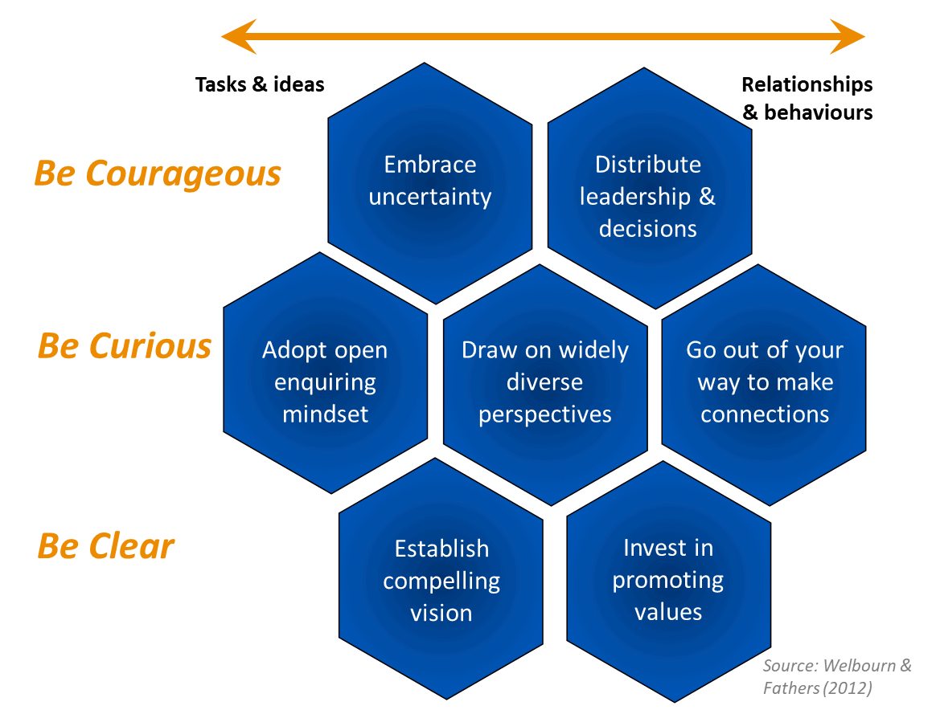
What is a System Leader?
“Working beyond organisational boundaries on challenges of mutual concern that cannot be solved by any one person or institution”

Slide 3
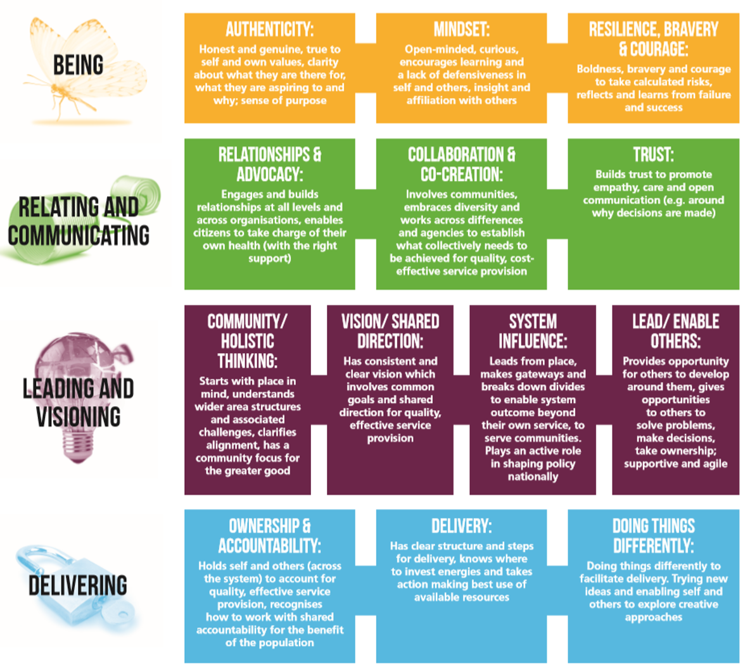
Behaviours of a System Leader

Slide 4
System Leadership as part of my role

Slide 5
What I do as a Systems Leader?
Bring people together:
Build a ‘coalition of the willing’
e.g. Parenting Strategy for Craven, Children’s Mental Health
Ask questions:
Gaps in provision
Sharing successes
Duplication of services
Inefficient use of public money
Putting Craven on the map
Build an evidence base, building outwards:
A case for change
Involve parents, children and young people through feedback
Provide stability

Slide 6
Why be a System Leader?
“You can achieve almost anything if you don’t want to take the credit”
Helps me live my values and the vision of SELFA
I can make the biggest change for children and young people working in this way
It prevents SELFA from working in a silo
Helps me develop transferrable skills like emotional intelligence, empathy and persuasion
Holds others accountable for the work they do
Incidental points, but still worth noting!
Funders like it – Generous Leadership
Sometimes I get paid for it – Garfield Weston “strengthen leadership and governance”, Craven Communities Together, Health Equity
Fellowship & VCS Alliance - Backfill

Slide 7
What difference have I made as a System Leader?
Brought real-life problems to commissioners and asked them to help find solutions, and felt heard
Brought together partners who are working on similar agendas
Helped to identify gaps and support provision to fill these gaps
Have an equal seat at the table in discussions about services for children and young people in Craven
Put Craven on the map in terms of North Yorkshire and Bradford & Craven
Benefited children and young people at SELFA through partnership working and collaboration
Applied for the Health Equity Fellowship

Slide 8
How you can help be a System Leader!
Convene & Commit – Engage in conversations to find common ground and commit to work together to create change to your systems
Look & Learn – mapping, dynamics, shared understanding, do your homework!
Engage & Energise
Act with Accountability
Review & Revise
Access training that’s available – BTHFT - Emma.Jackson@bthft.nhs.uk

Slide 9
THE END
Any questions?

