Slide 1


Primary Care Networks in the Community

Slide 2
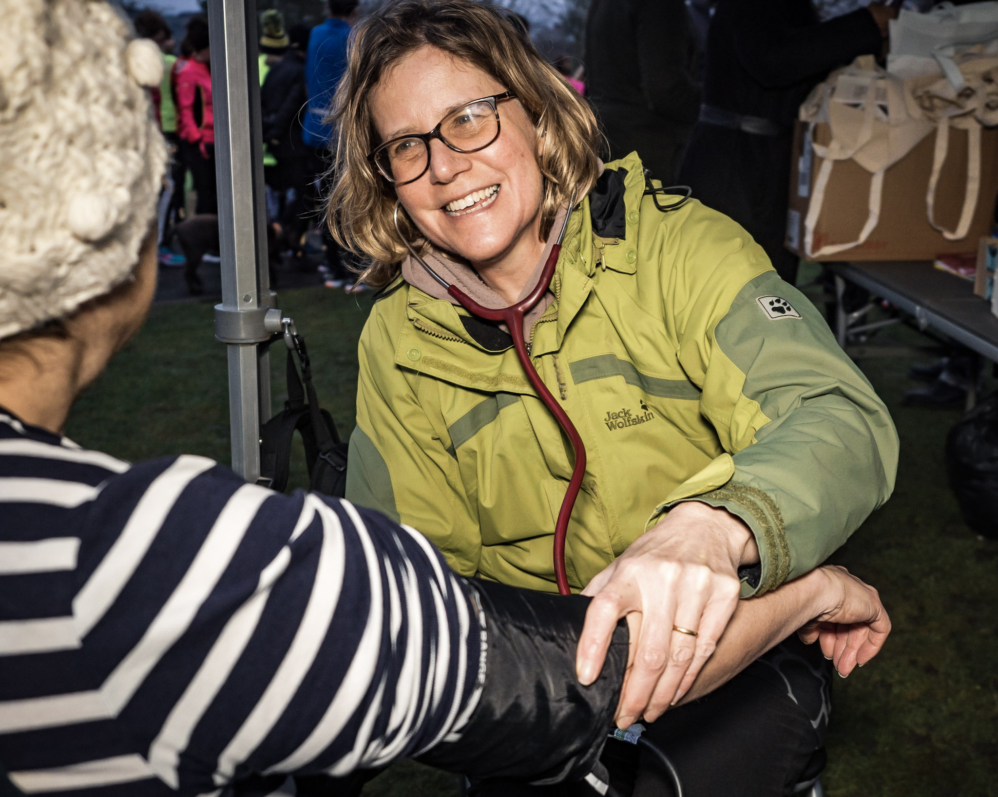

Community Health Checks
BMI & Blood Pressure Checks
Expected to role out into Craven in January 2022
Upskilling Volunteers

Slide 3
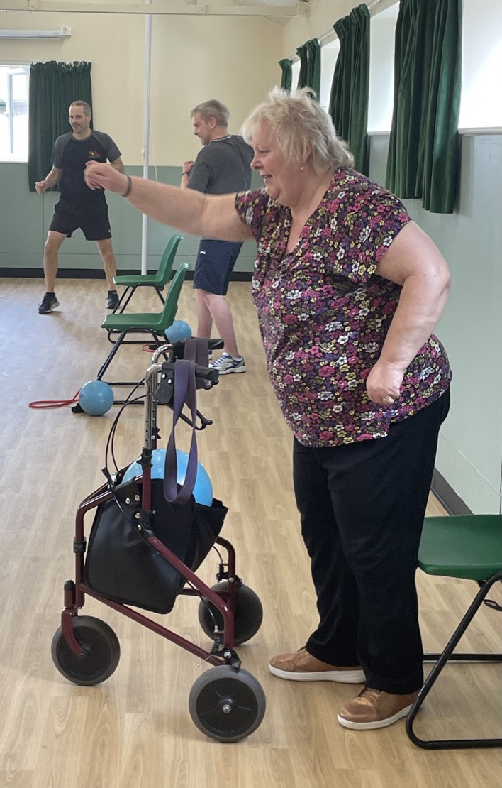
Lifestyle & Exercise Classes
Weekly classes available in Skipton and online for people with chronic conditions who want to make changes to their lifestyle and exercise with confidence.
Plans to start in North Craven in the new year.
Fully funded for WACA & Modality Patients
Quotes from Patients:
"I am improving. Even from 4 weeks ago my balance is so much better and I am more confident out and about.“
"I am thinking more about what I eat and I marched up the hill with the dog; I was out of breath at the top and it actually felt good! I even put make-up on for the first time in months on Saturday. It might only sound small to you, but it's progress."
Self Refer : Get Moving Exercise Classes - Eat, Move, Be Happy (eatmovebehappy.com)

Slide 4
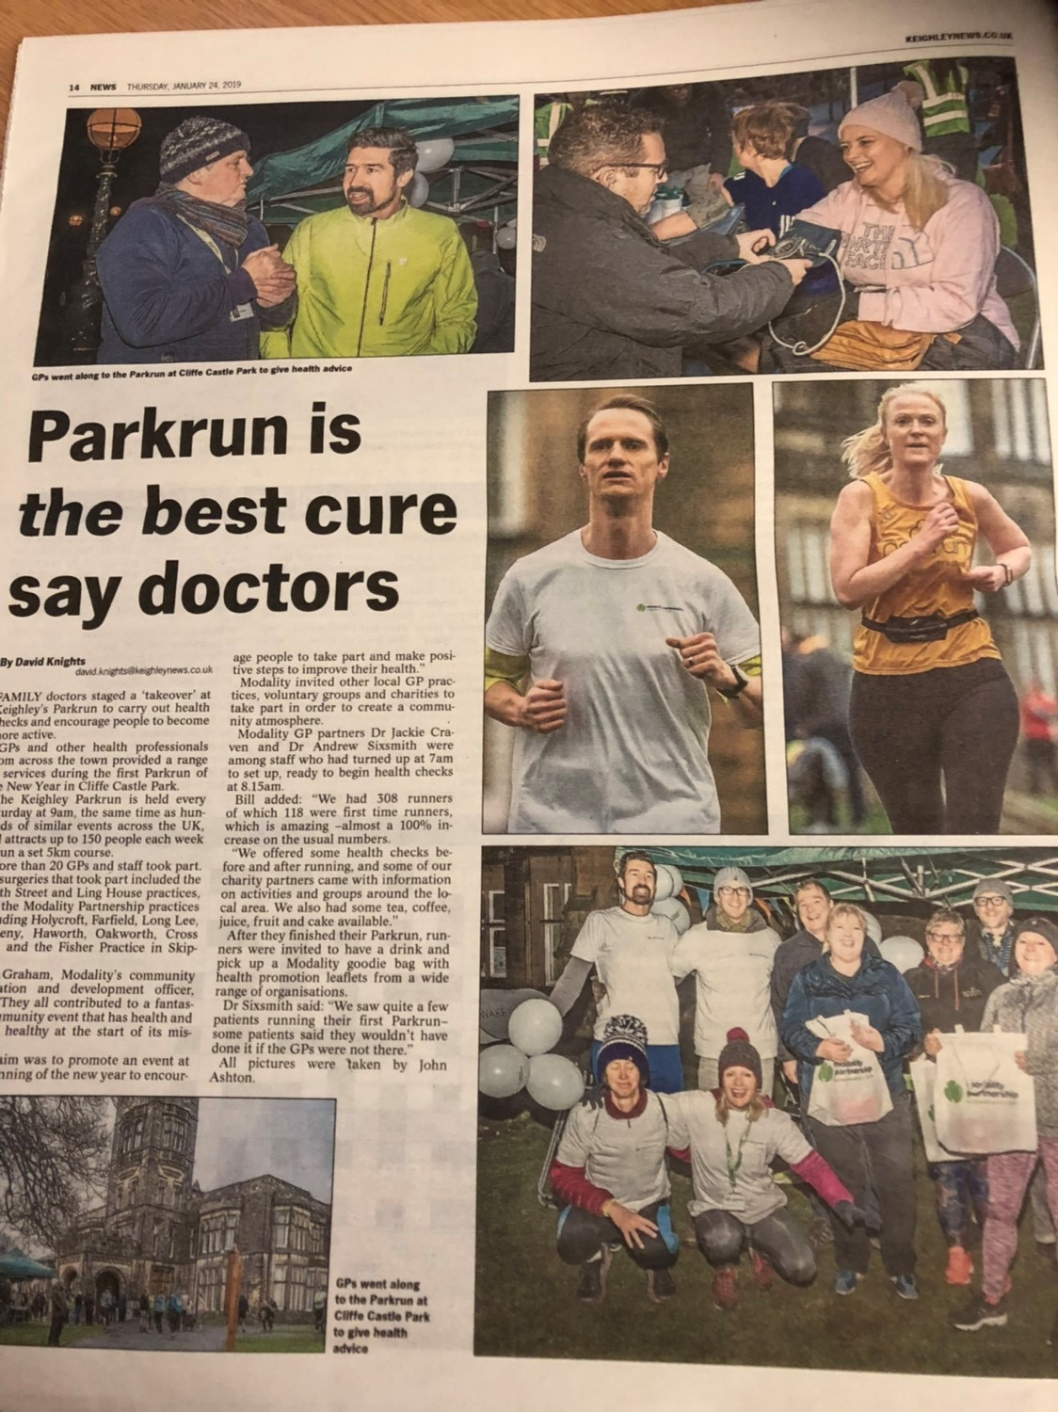
Park Run Events
The Airedale, Wharfedale & Craven Community Partnerships and Primary Care Networks WACA & Modality will be "taking over" Park run, putting on three very special events raising awareness of local community health initiatives.
Dates:
Ilkley Riverside Gardens (Junior Park Run) 21st November 9am
Cliffe Castle Park (Keighley)- 15th January 9am
Aireville Park (Skipton) - 19th March 9am

Slide 5
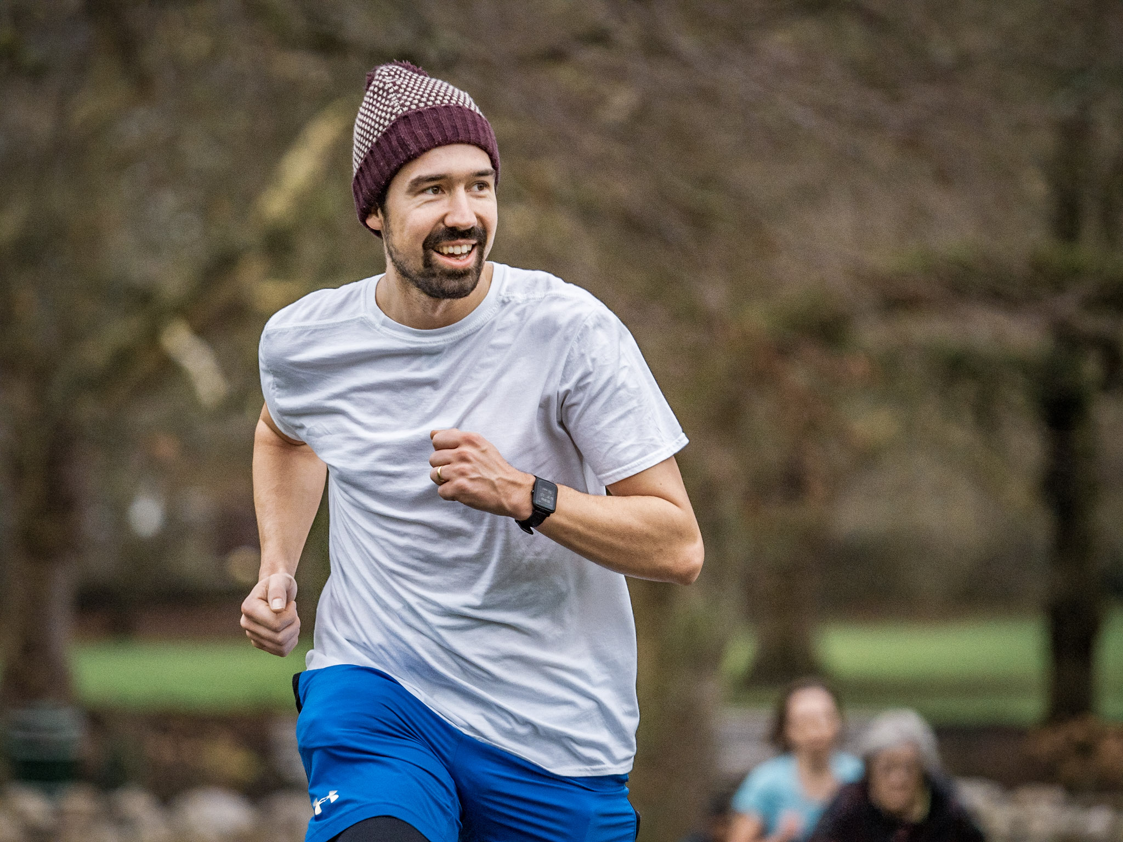
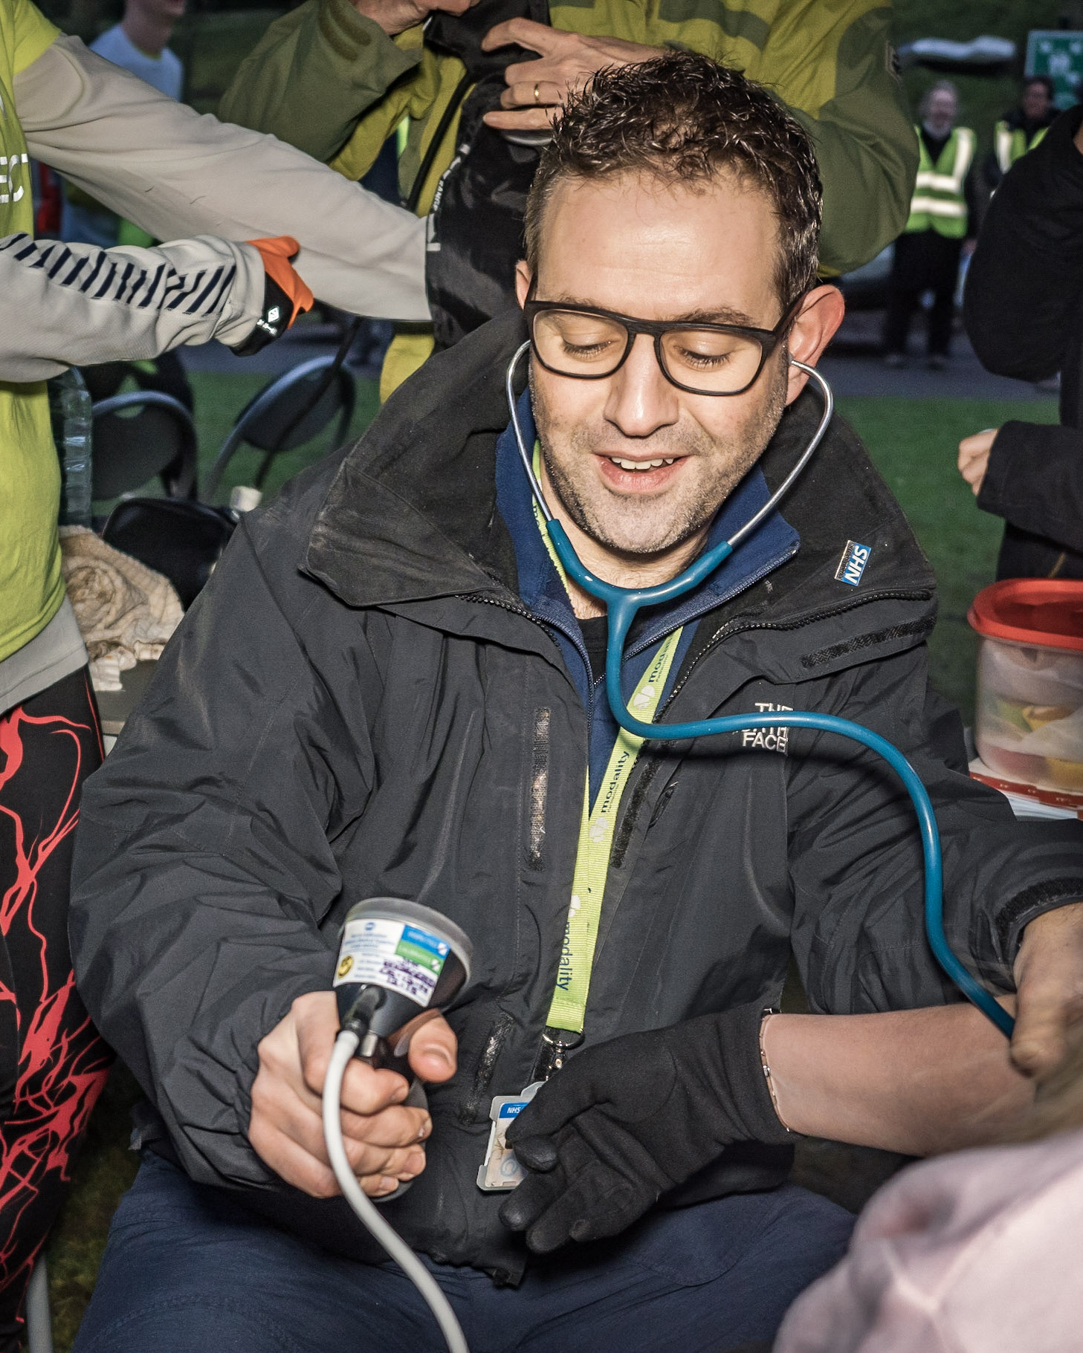
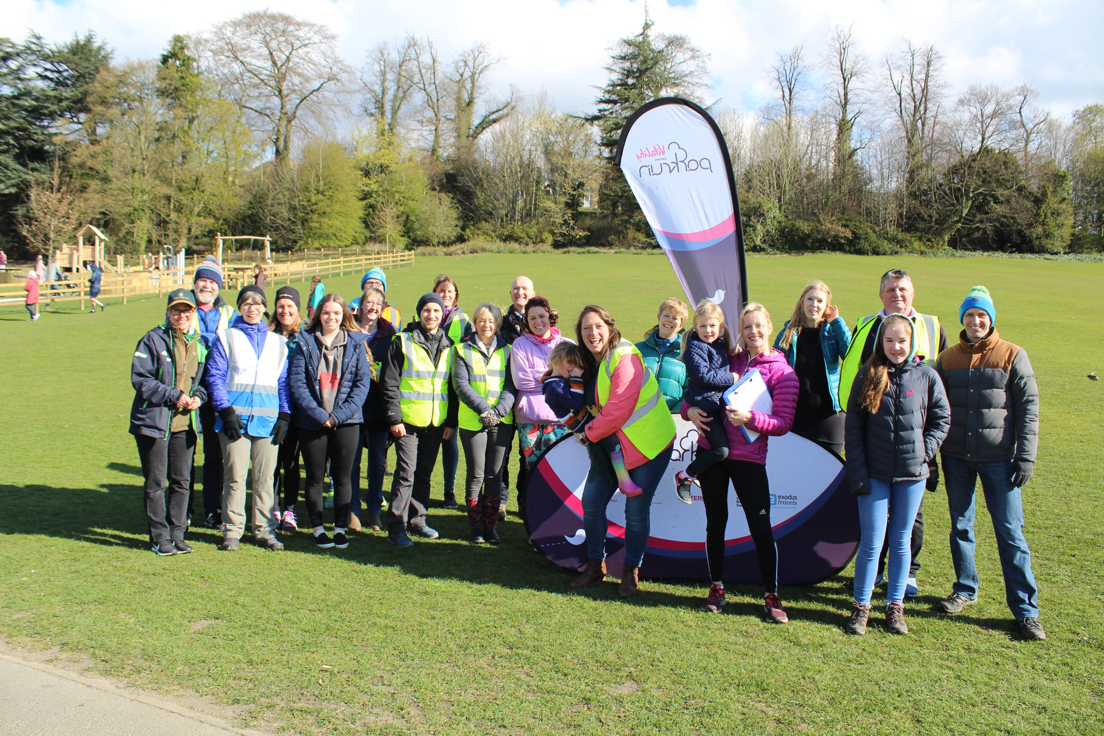

Slide 6
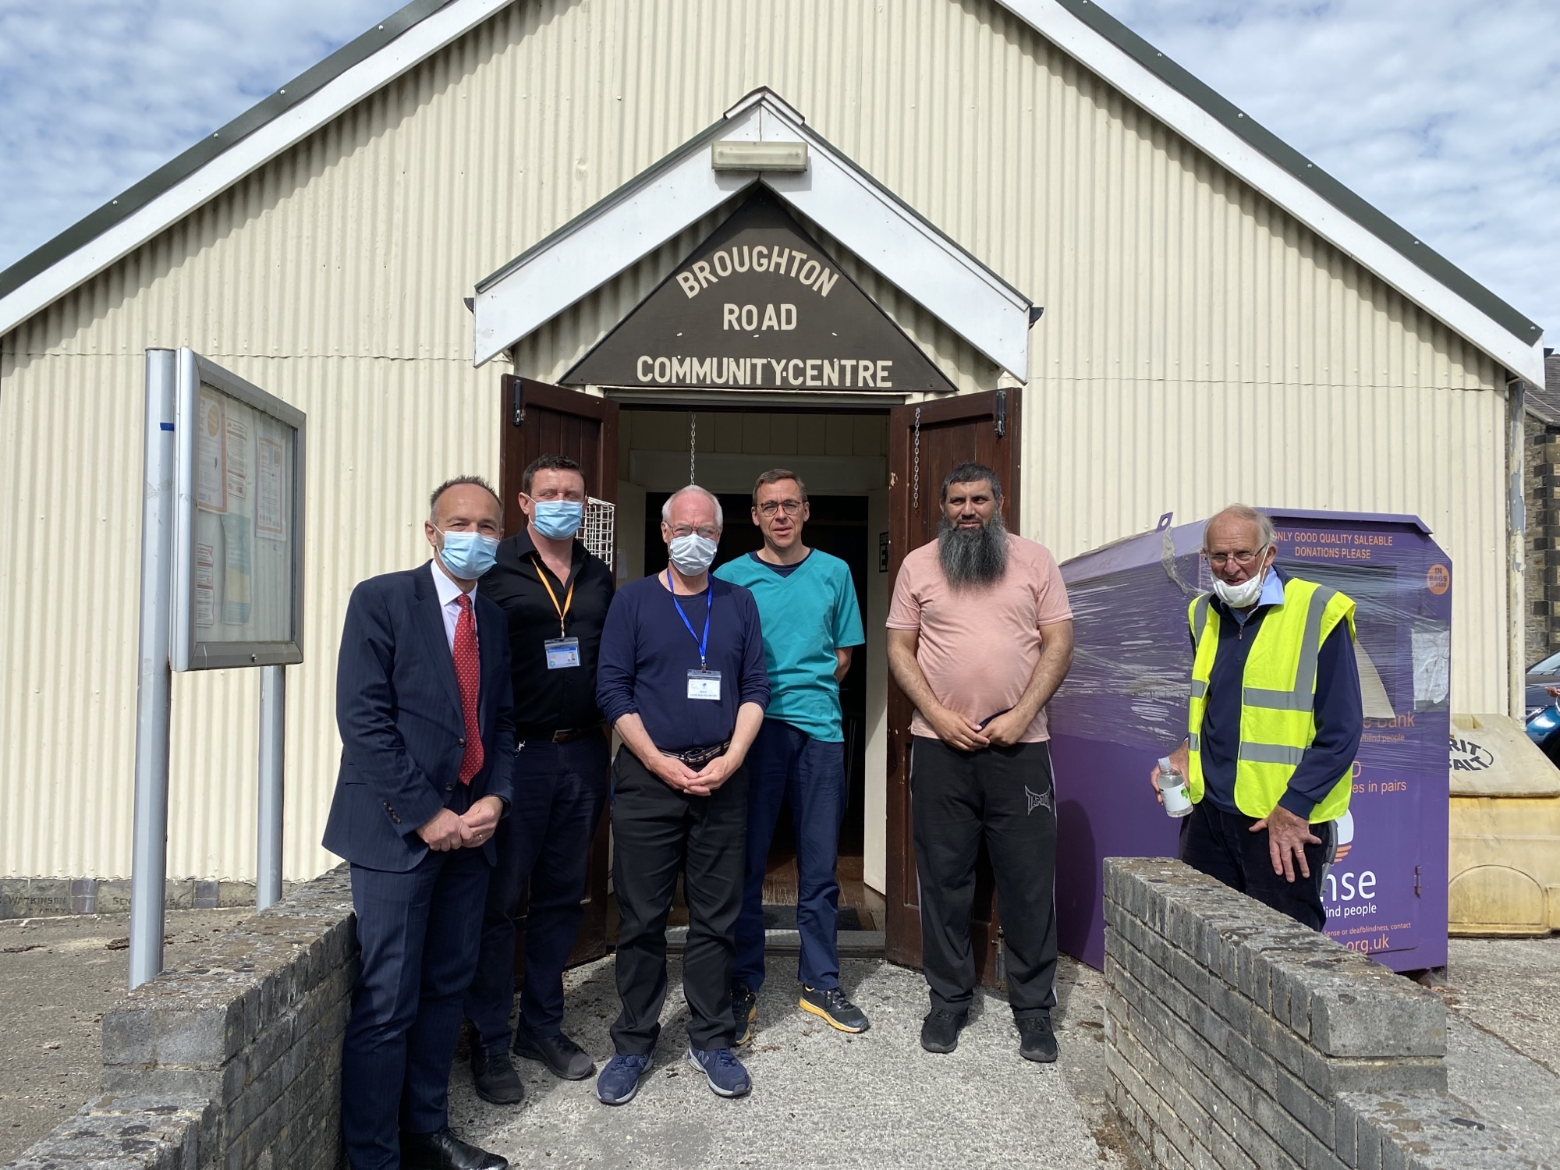
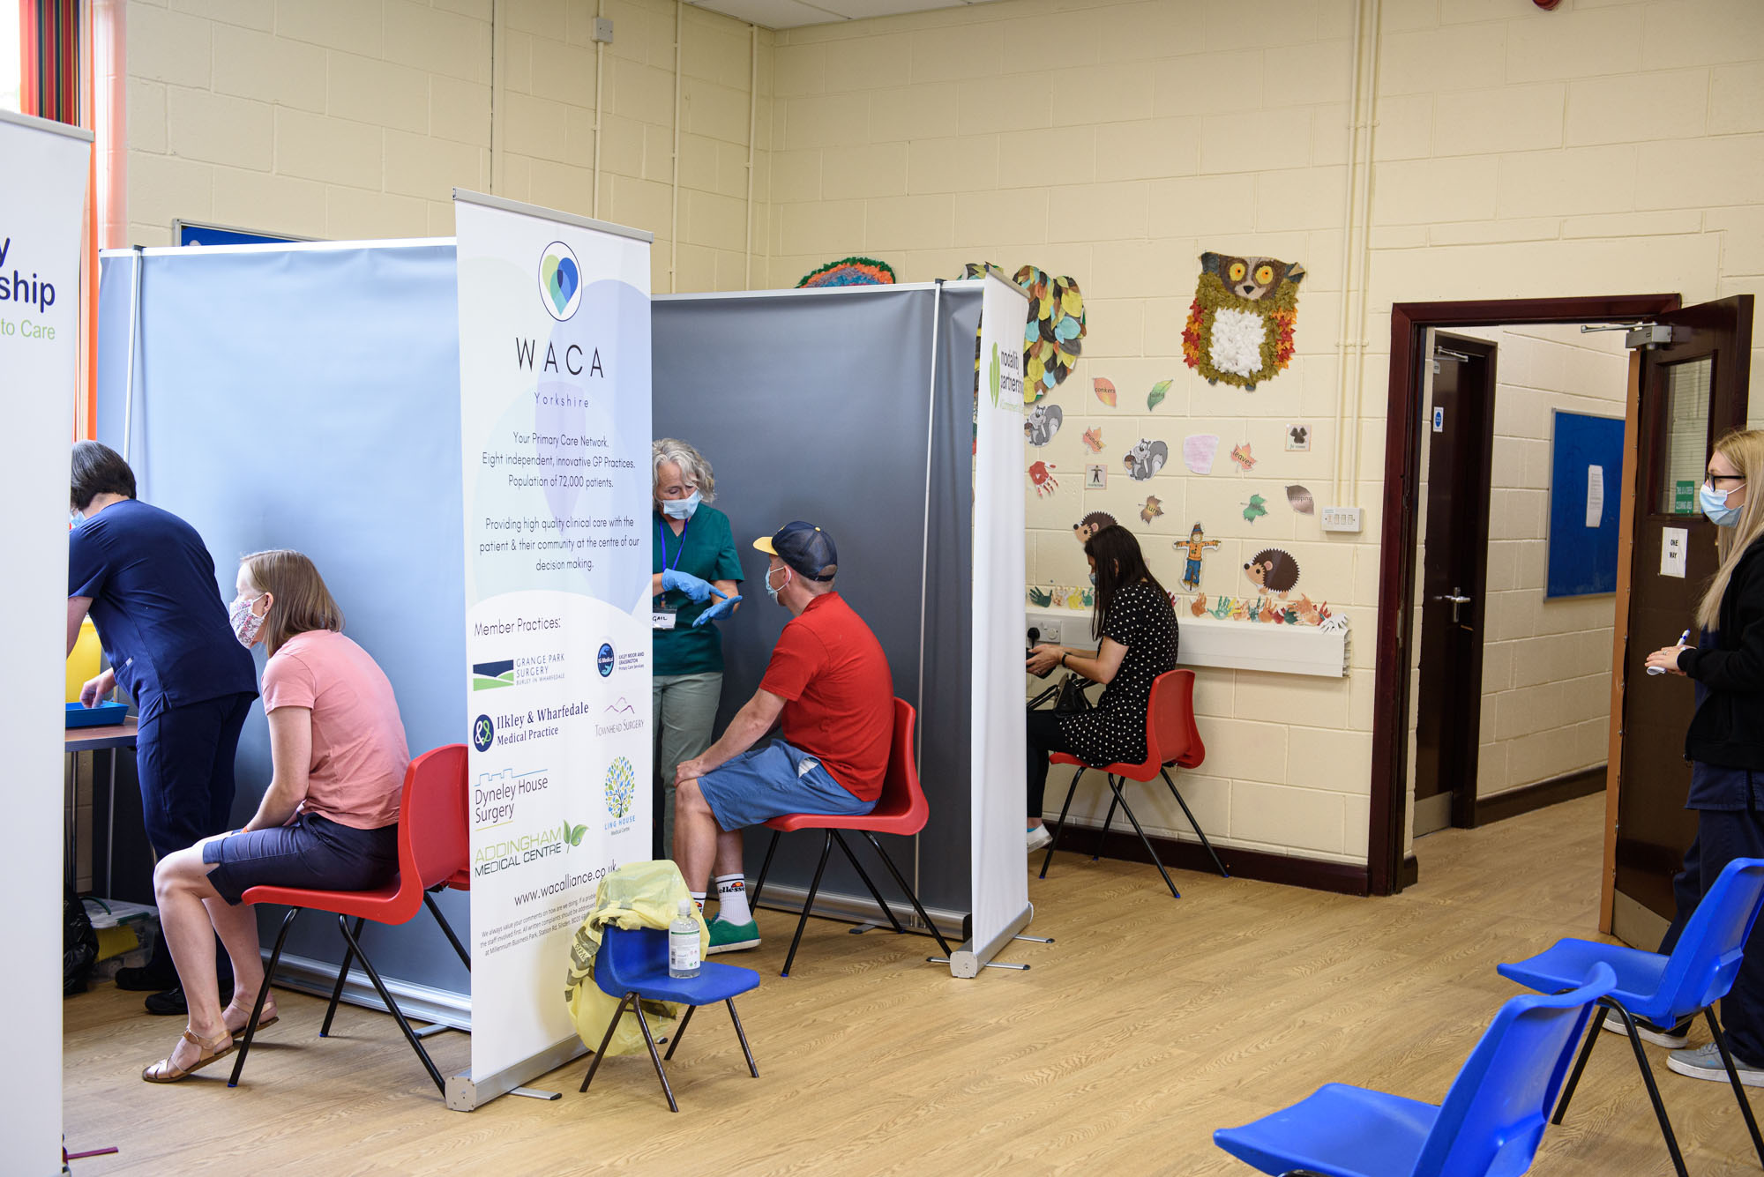
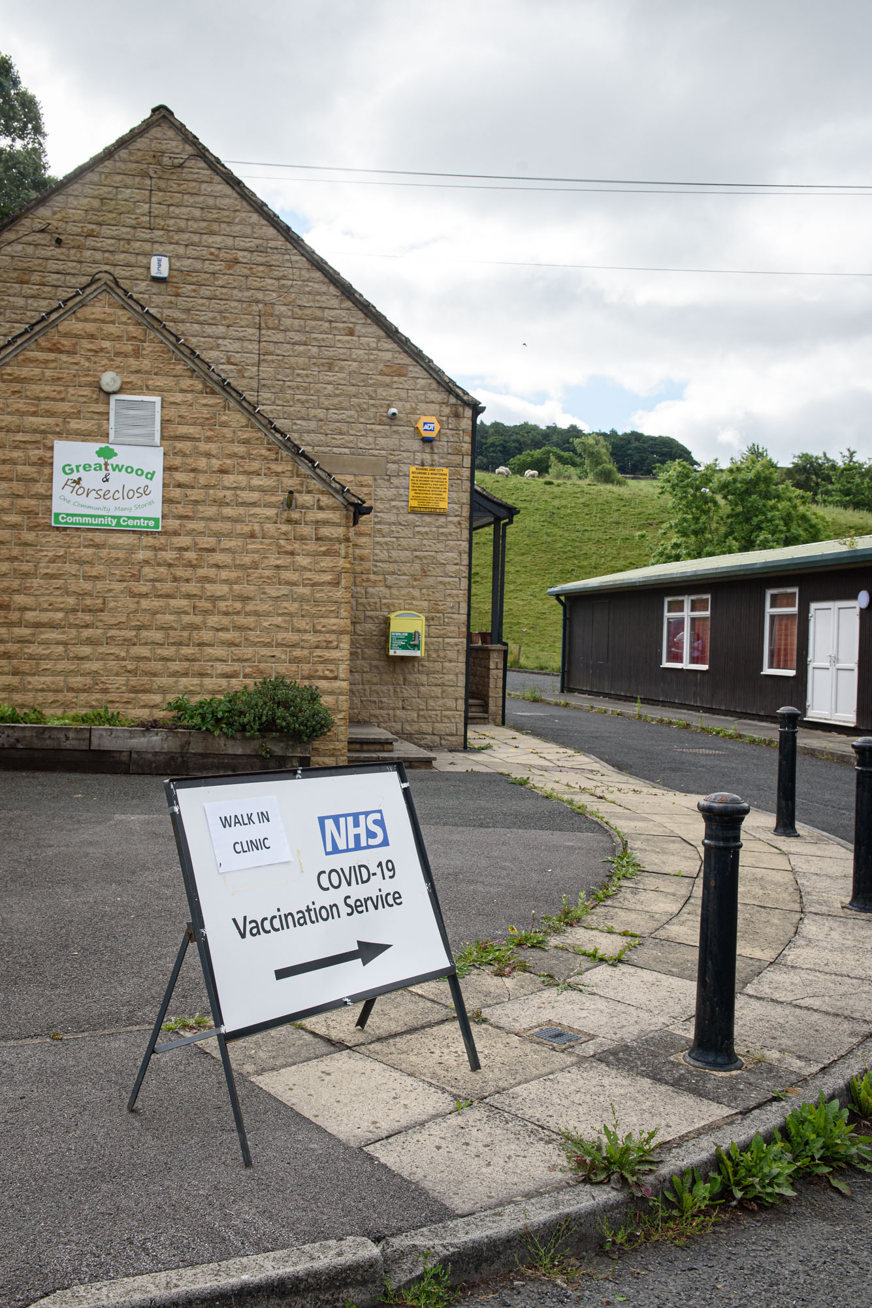
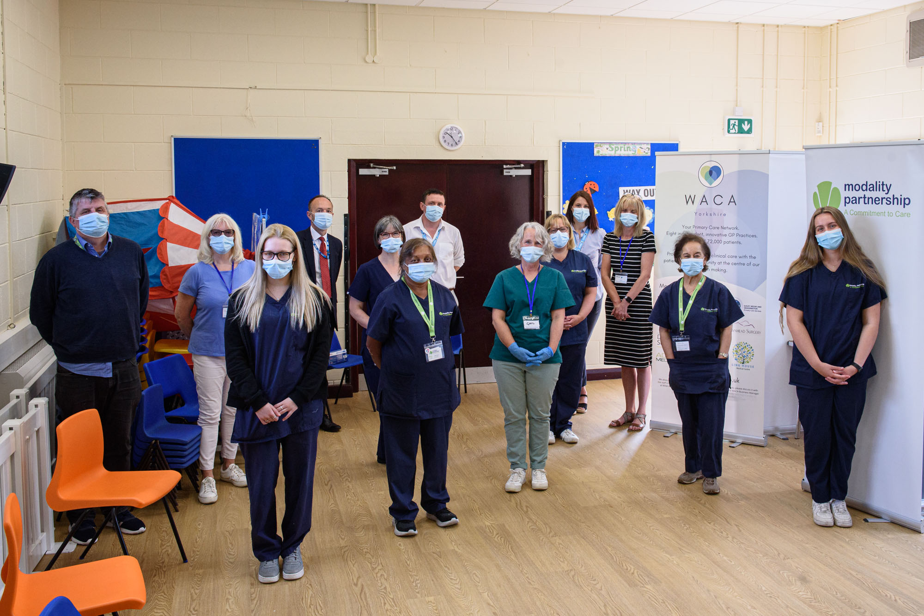
Community COVID Vaccinations Clinics

Slide 7
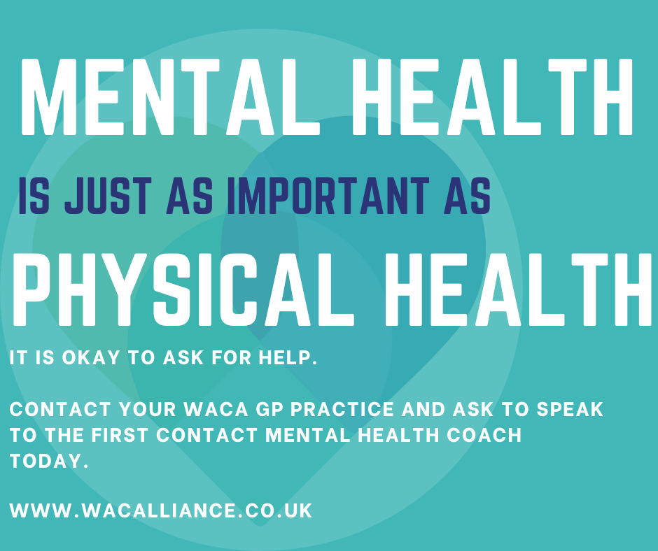
WACA First Response Service
First level of support for mental health provision throughout WACA Primary Care Network of GP Practice Surgeries.
New team of Mental Health Coaches based within GP Practices
Provide on the day appointments, supporting the mental health needs of patients.
Working with the Social Prescribing teams and NHS Mental Health Support to provide clinical step up, ensuring patients access the right help at the right time.

Slide 8
Modality Health Coaching Service
A dedicated team of qualified Coaches
specialised in coaching and behavioural change skills i.e. motivational interviewing.
Coaches working with identified patients to help develop their knowledge and confidence to become active participants in their care
provide access to self-management education (inc. recording day to day activity i.e. physical activity and diet), peer support and social prescribing 20-30 minute remote (telephone/video) consultations delivered
work with patients to identify their needs, set personalised goals and develop a personalised health and care plan.

Slide 9

GR8 Minds Service
Young Peoples Counselling & Social Prescribing Service (5- 18 years old)
Based in Craven Secondary Schools and WACA GP practices
Support with :
  stress and anxiety
  self-confidence and self-esteem
  exercise
  sleep
  education
  behavioural issues
  social support
  special needs
  long-term health conditions/disabilities
  bereavement
  family changes such as divorce or relationship breakdown

Slide 10
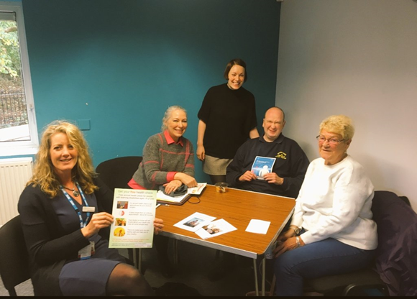
Learning Disability Health Checks
Working with key partners to set up LD specific events across Craven
Provide LD Health Checks & Action Plans in community locations

Slide 11
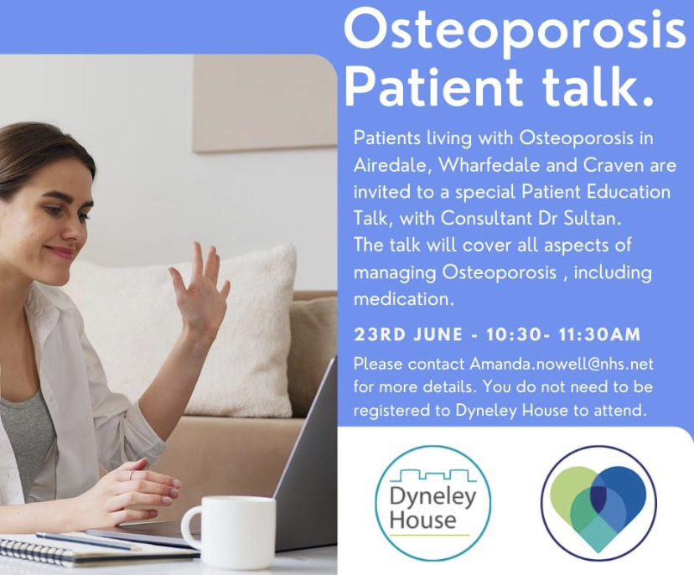
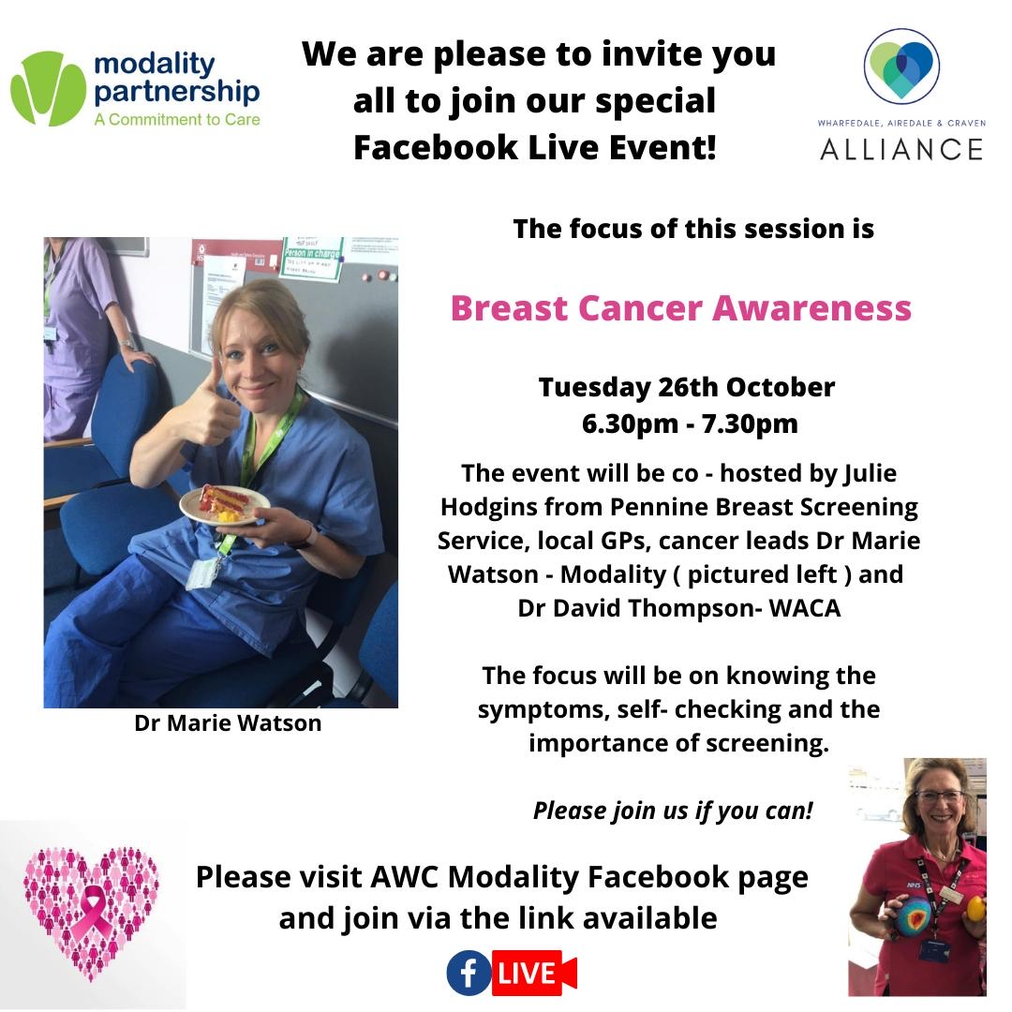
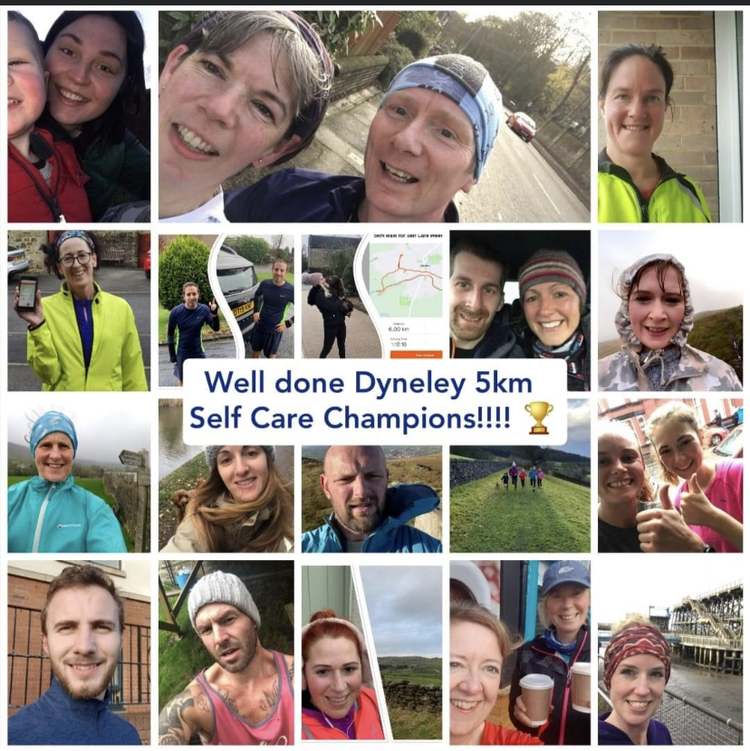
Self Care & Health Education Events

