Slide 1

Craven Health Inequalities

Slide 2

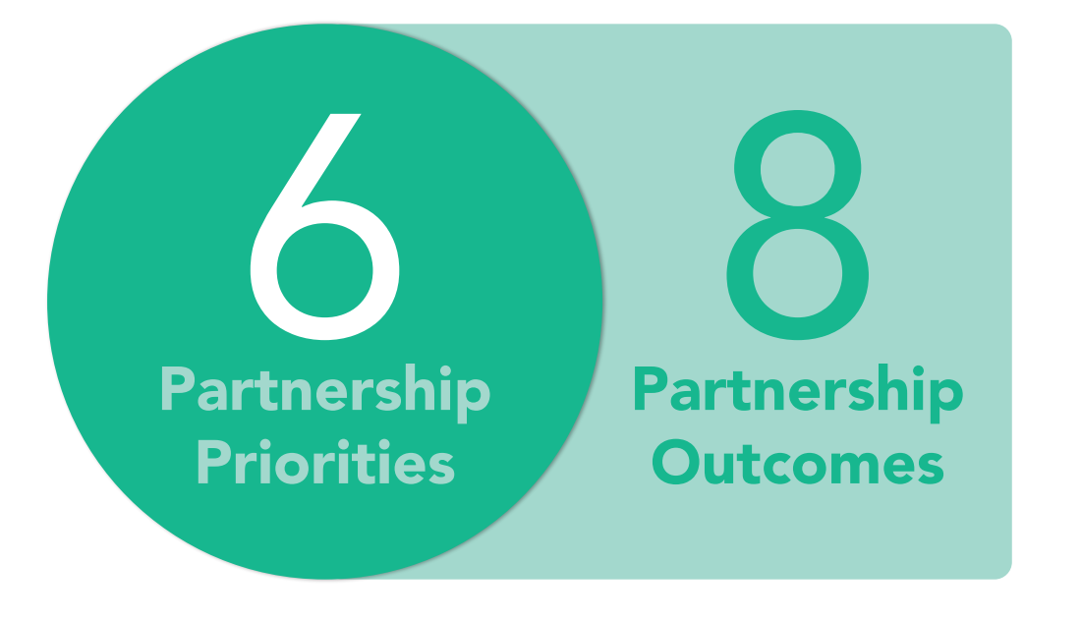
Craven Health Inequalities

Slide 3
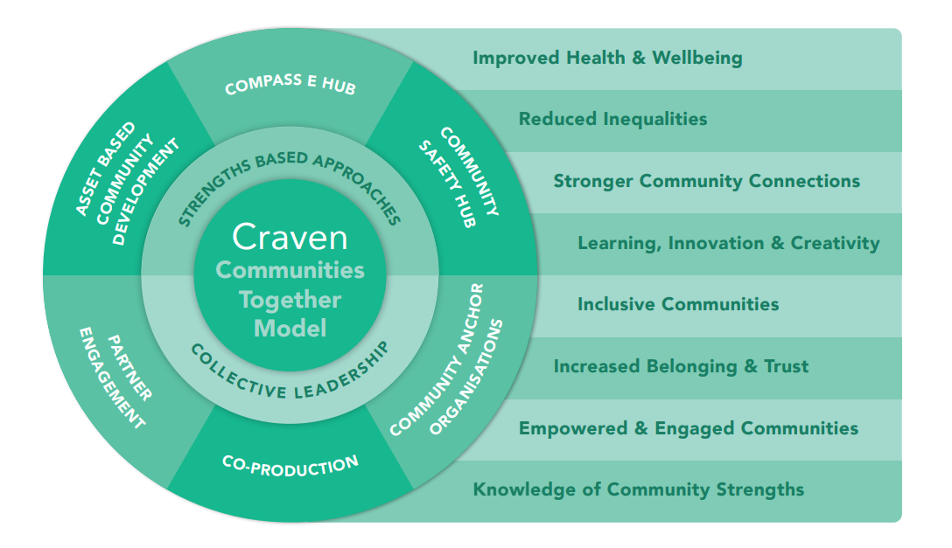
Craven Health Inequalities

Slide 4

Craven Health Inequalities
The Health Inequalities Workshop Methodology
5 breakout sessions were held to consider Access to Timely Support:
a. What barriers have you encountered or observed in accessing timely support?
b. What does improved access to timely support look like? Key enablers?
c. What does improved access to timely support look like for adults? Key enablers?
d. What does improved access to timely support look like for children & young people? Key Enablers?
A follow up Mentimeter Exercise asked:
How do you think our Partnership can help to improve access to timely support?
Who do we need to include to achieve improving access to timely support?

Slide 5
Craven Health Inequalities
Themes:
Primary care – difficulties in contacting, increase in virtual appts – digital divide
First Response – distance/travelling to North Craven
Transport – affordability, location and frequency of public transport
People with a disability – exercise, respite for families, lack of interesting things to do in the day, reduced mobility
Information - not accessible, lack of.

Slide 6
Craven Health Inequalities
Themes:
Individual reasons: reluctance to face health issues, confidence level, structures/criteria
Mental health - people becoming more isolated, difficulty getting appts, CAMHS eligibility threshold / resources for C&YP, lack info.
Mismatch: Need & Resources – collaboration, sharing resources, assets, venues; adapting provision of services and support. Funding - for inc. workforce; targeted at areas given decision making powers
Carers – adults and young carers vulnerability exacerbated by C19

Slide 7
Craven Health Inequalities
Themes:
Specialist services - Bradford based, locally need to adapt to address cultural diversity/different cultural expectations
Accommodation - difficult to find accessible/ suitable spaces rurally
Isolated communities – poorly set up with little or no services
Community - opposing views can become a barrier for new initiatives
Local intelligence – empowering local organisations/community to provide support to enable improved access to services

Slide 8
Craven Health Inequalities
Themes:
Technology - people unable to use tech, inappropriate use of A&E
Volunteers need training (i.e., first aid, mental health)
Children and young people – VCS services can only dip in and out; lack of provision for teenagers, esp. North Craven; inclusion for children with special needs
VCS – use local organisations to deliver inclusive activities, break down barriers, bring skills and knowledge in engaging the ‘hard to reach’; skill up local partners
Dementia - day care and respite lacking

Slide 9
Craven Health Inequalities
Mentimeter feedback:
How can our Community Partnership help improve access to timely support for people?
Identify and remove barriers/obstacles in the system
Collaboration/integration/joined up approach / sharing resources
Bottom-up and proactive approach
Engaging with, and promoting, services at place
Develop clear/consistent/engaging comms strategy
Share experience/challenges/learning to understand / escalate / create solutions
Work with commissioners so they really understand the challenges in Craven
Challenging the system to provide more support and resource
Take services to people – particularly in rural areas

Slide 10
Craven Health Inequalities
Mentimeter feedback:
Who do we need to include to improve access to timely support?
Faith Sector
Private Sector
VCS Organisations
Patients/Service Users/ Residents/Citizens
North Yorkshire Transport
Police
Health (NHS) and Social Care Organisations
Digital Services
Local Government
Commissioners

Slide 11
Craven Health Inequalities
Next Steps:
Community Engagement We need to find out about personal experience of challenges of ‘access to timely support’
Either with people with lived experience (e.g. MH / C&YP) OR specific geographic communities e.g. Broughton Rd, Greatwood, north Craven.
How do you think we should engage with people?
How can you support us with this?
Then:
2. Sub group(s)to consider the feedback, the themes, prioritise according to what we can influence inviting representatives from Partnership and specialist services
Thoughts?

Slide 12
Craven Health Inequalities
Next Steps

