Slide 1
Age Friendly Communities
Carly Walker, North Yorkshire County Council
And
Jonathan Kerr, Age UK Craven

Slide 2
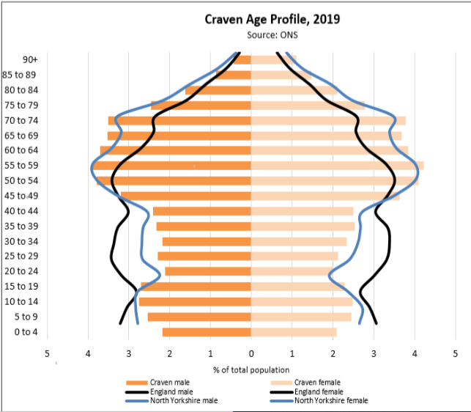
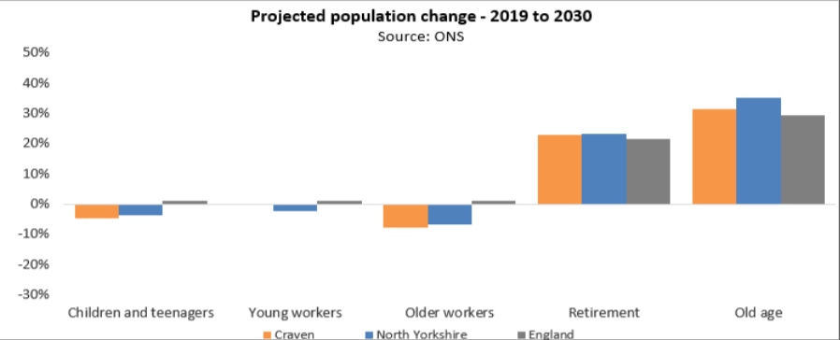
Craven age profile

Slide 3
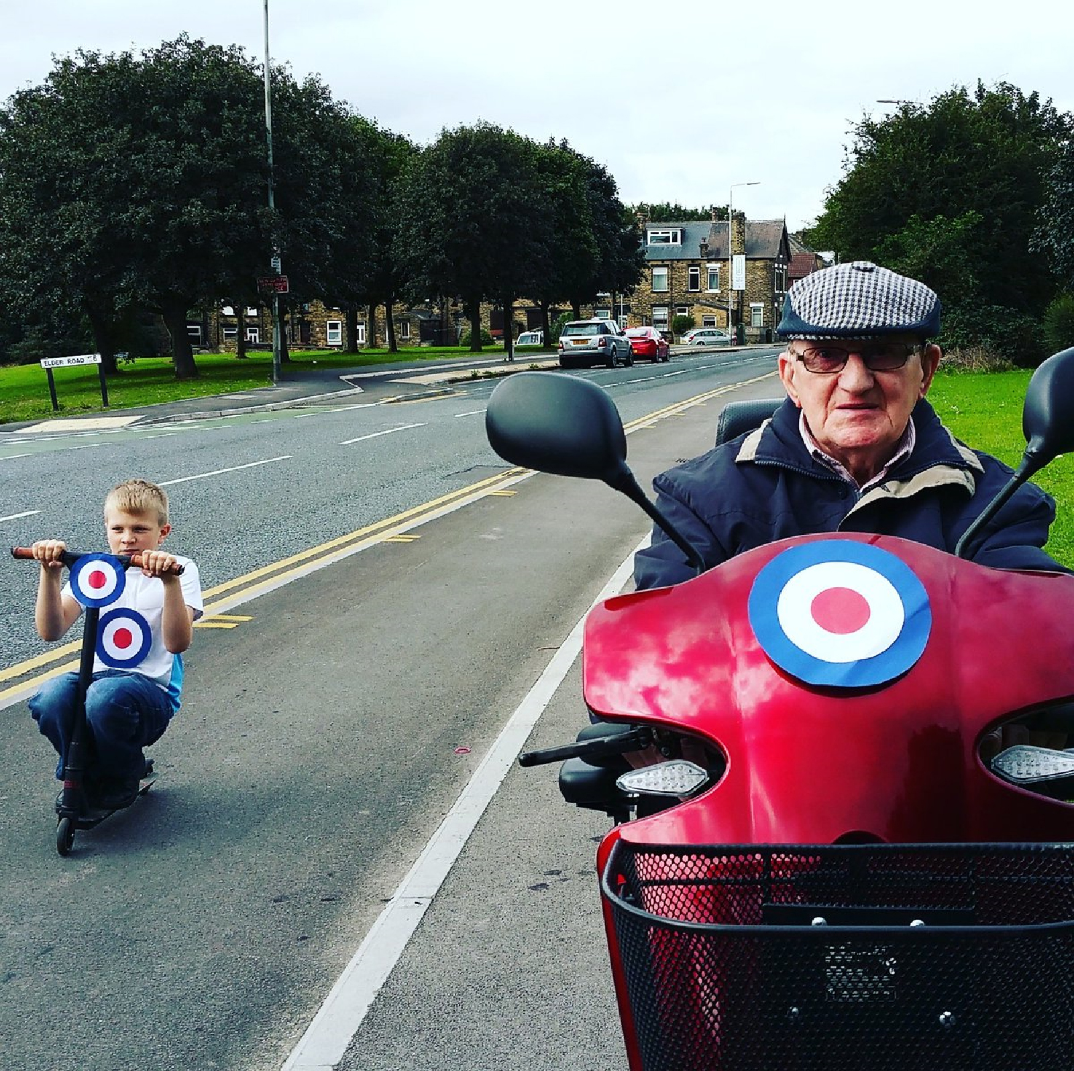
Age-Friendly Communities – a holistic approach to ageing better
Concept developed by World Health Organisation (WHO), 2006
Age-friendly communities are
places that foster healthy and active ageing
Age-friendly communities enable people to
stay in places of their choosing as they age
and to continue to play an active role in their
communities for as long as possible
Age-friendly communities minimise barriers to participation as abilities decline
Notes:
3

Slide 4
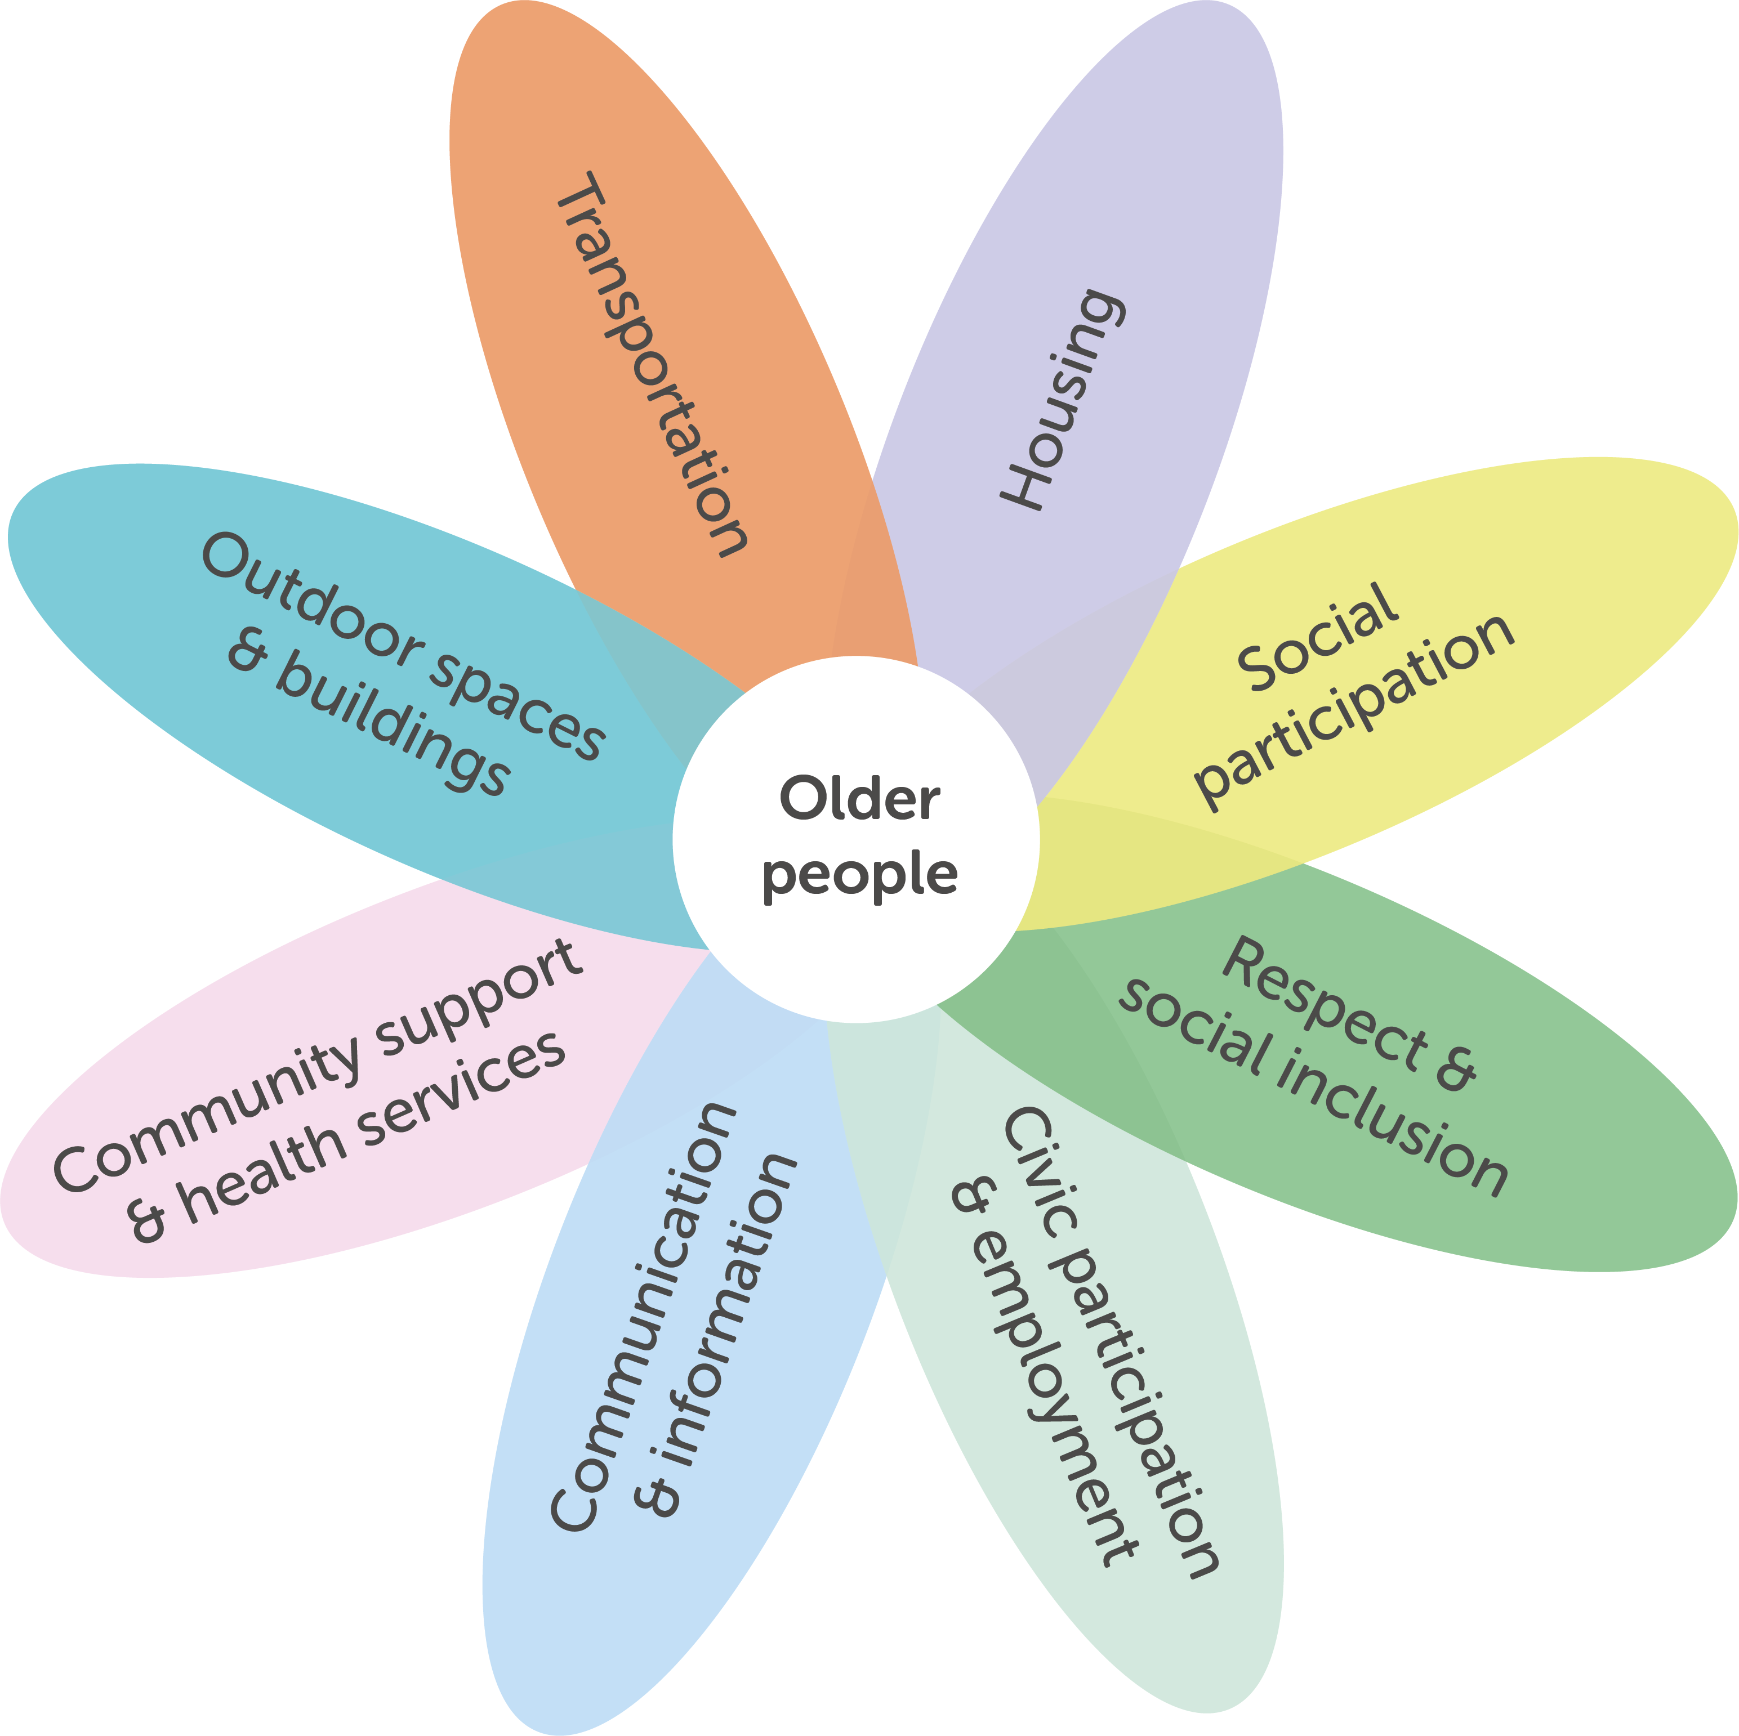
The Age-Friendly Communities Framework
Built Environment
Social Environment
4
Notes:
4

Slide 5
Four steps to becoming an age friendly community
Engage and understand
Plan
Act and implement
Evaluate
www.ageing-better.org.uk/sites/default/files/2020-08/Age-friendly-communities-A5.pdf

Slide 6
Settle pilot and next steps
Meeting held to discuss how this also links into other agendas e.g. family friendly, dementia friendly
Links in with West Yorkshire and Harrogate ‘Act as One’ system priority of Ageing Well
Engagement to take place
Voice of older people work also taking place across North Yorkshire

