Slide 1


Slide 2
Purpose
Reduce isolation and loneliness
Community led initiative
Enhancing Connections through mutual interests
Widening opportunities, shift from 1-1 – group support
Inspiring others
Improving health & well-being
Support local businesses
Accessible e.g social prescribing teams, Living Well,
Fundraising opportunities
Next step in building our community – Recovery phase

Slide 3
Nature of the group
Range of inclusive opportunities – ages, ability levels, free activities -0-5K, Mindful Walks, Bike Maintenance, Korfball to Paddle boarding Wild Swimming
Sports Leaders
Open to everyone
Shared experiences
Friendly & supportive
Inspired by Active Filey

Slide 4
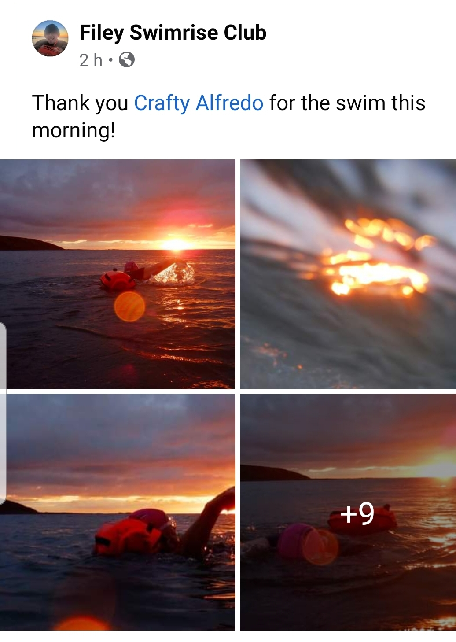
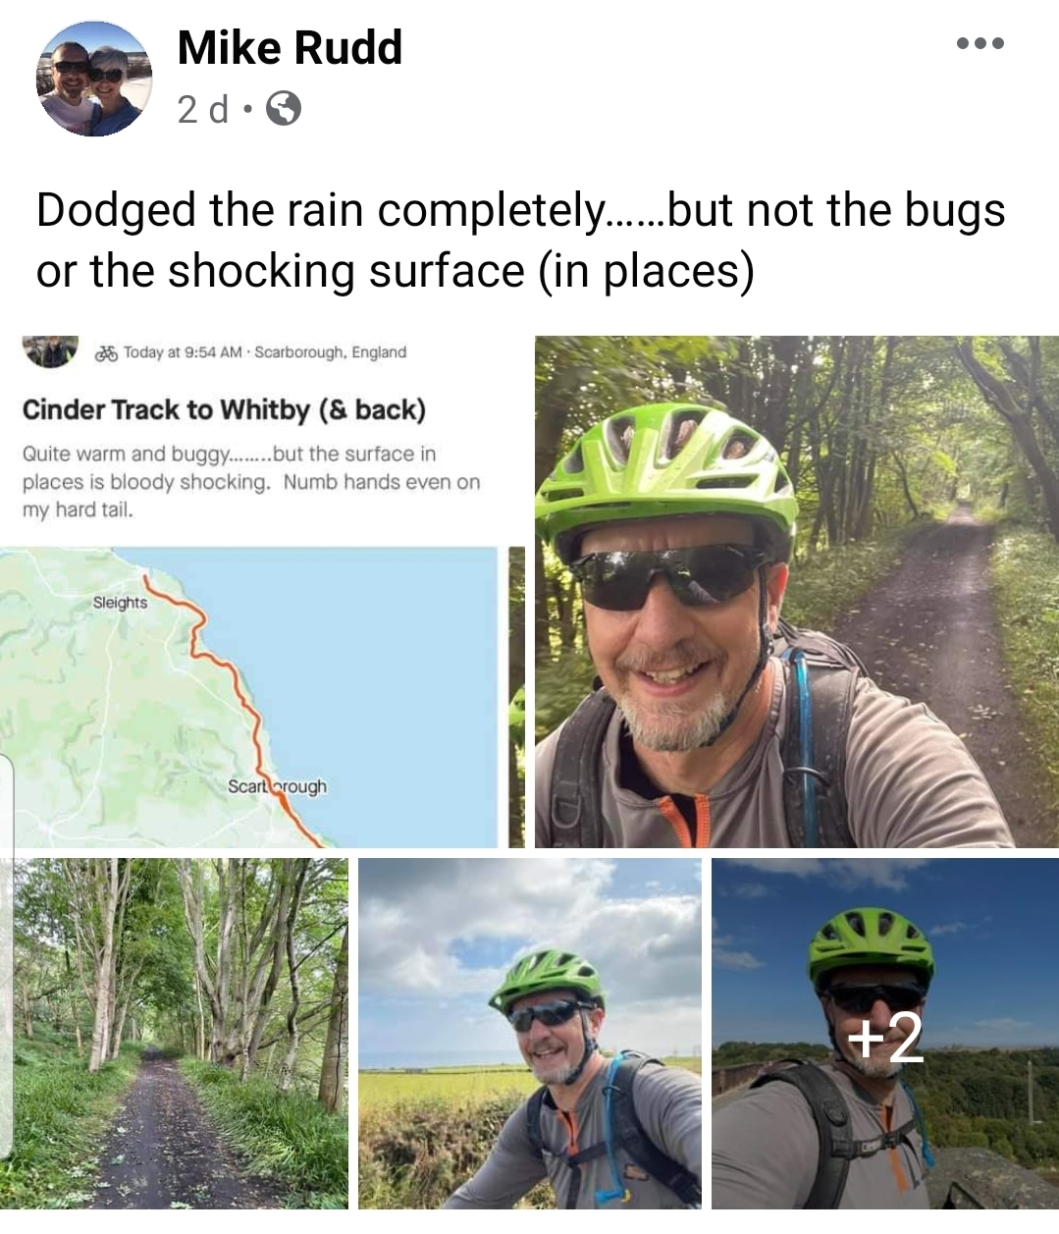
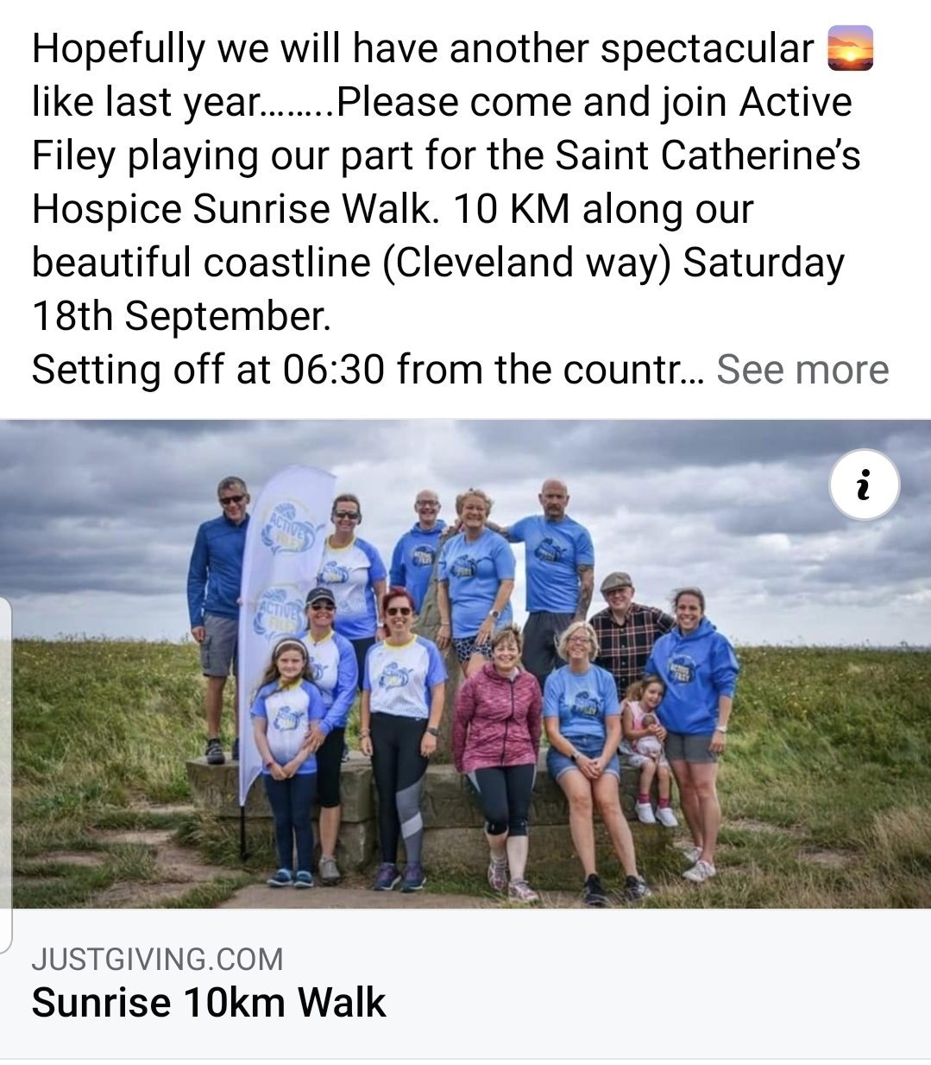

Slide 5
Development
Key people to drive & develop
Thought?
Questions?

