Slide 1
Craven Communities Together
Children & Young People’s
Mental Health
Wednesday 21 October 2020

Slide 2
Emotional Wellbeing Group (EWB)
Who is involved
Our Terms of Reference
Key Achievements in the last 18 months
Impact of COVID-19 on our work

Slide 3
“We need to remember that how we decide is as important as what we decide. We often choose to focus on a solution rather than a process that brings us to a solution. Collaboration is more than a tool in a toolbox. When collaboration works, it reproduces and builds the characteristics of civic community, allowing us to deal with future issues in constructive ways. Collaboration builds social capital.”
Tamarack Institute

Slide 4
Emotional Wellbeing Group (EWB)
Set up in March 2019 specifically to look at C&YP Mental Health, started off with 5 organisations coming together
Collaboration of Health, Social Care & Voluntary Sector

Slide 5
Emotional Wellbeing Group (EWB)
‘working together to define clearer referral pathways for emotional wellbeing support, and to identify gaps in provision’
Establish how to make effective use of our resources by working collaboratively
Identify clearer referral pathways
Ensure provision for Craven is not just a ‘tick box’ exercise
Complete a document outlining all services
Collate data to show need for resources in Craven and highlight different provision in Craven due to rurality

Slide 6
Emotional Wellbeing Group (EWB)
Key achievements in the last 18 months:
Revised referral pathway document
Report on Mental Health Services for Children and Young People in Craven
Collaborative working during Covid-19
Clear direction for C&YP Mental Health provision in Craven going forward

Slide 7

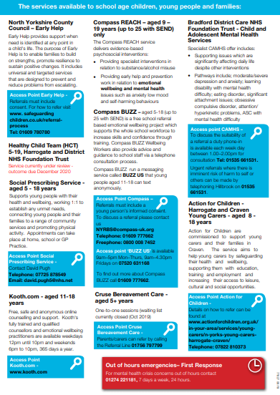

Slide 8
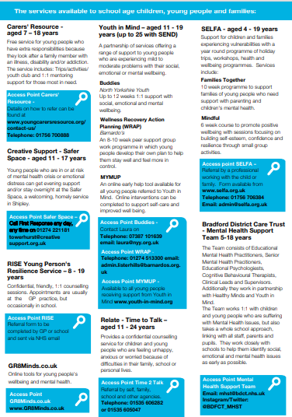
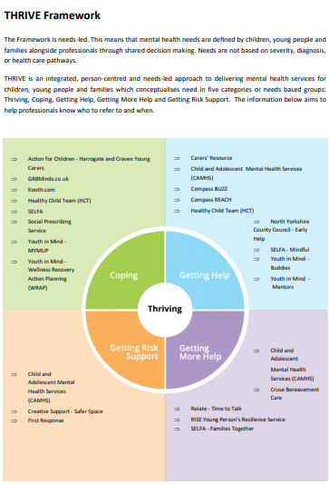

Slide 9

Emotional Wellbeing Group (EWB)
Report on Mental Health Services for Children and Young People in Craven
Key Themes:
Waiting times to access services
Not being offered appropriate support and a lack of support from schools
Services being complicated to understand with a lack of a coordinated, joined-up approach
Lack of accessible support for parents and carers
Links with the key findings from the Bradford and Craven Independent system-wide review of the children & young people’s mental health system.

Slide 10
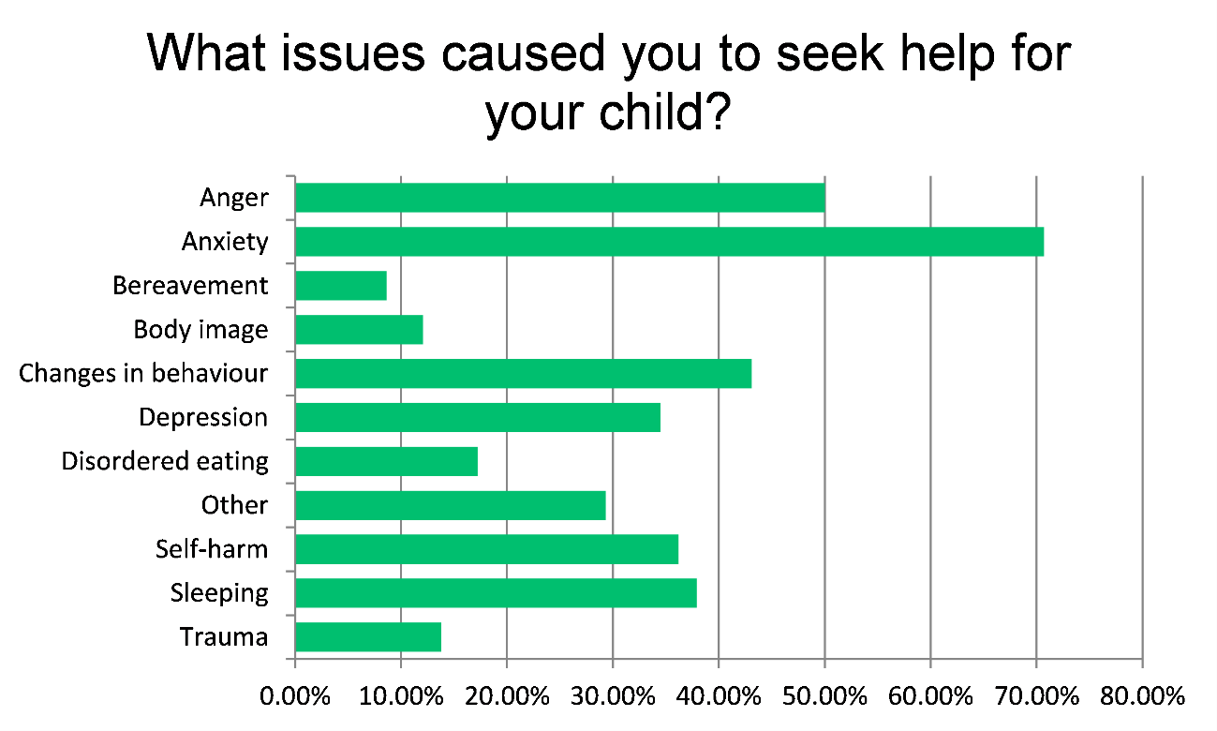
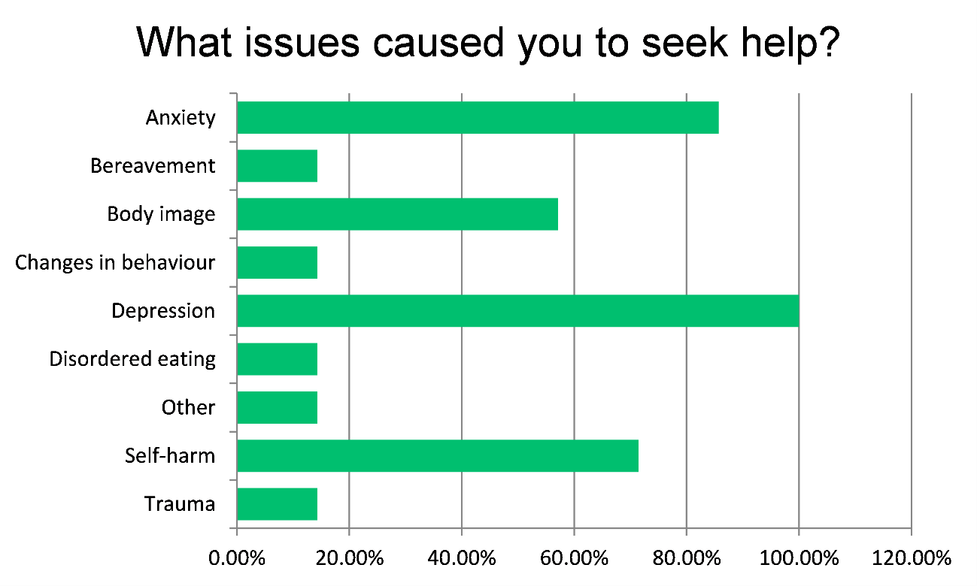

Slide 11
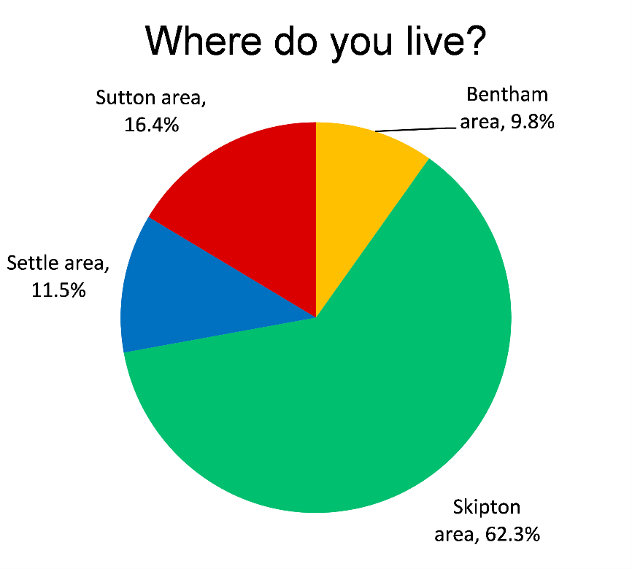
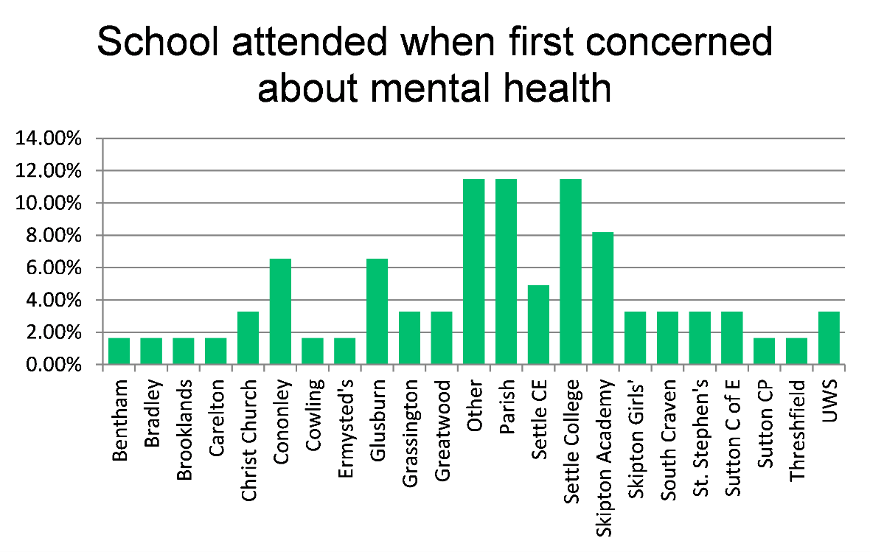

Slide 12
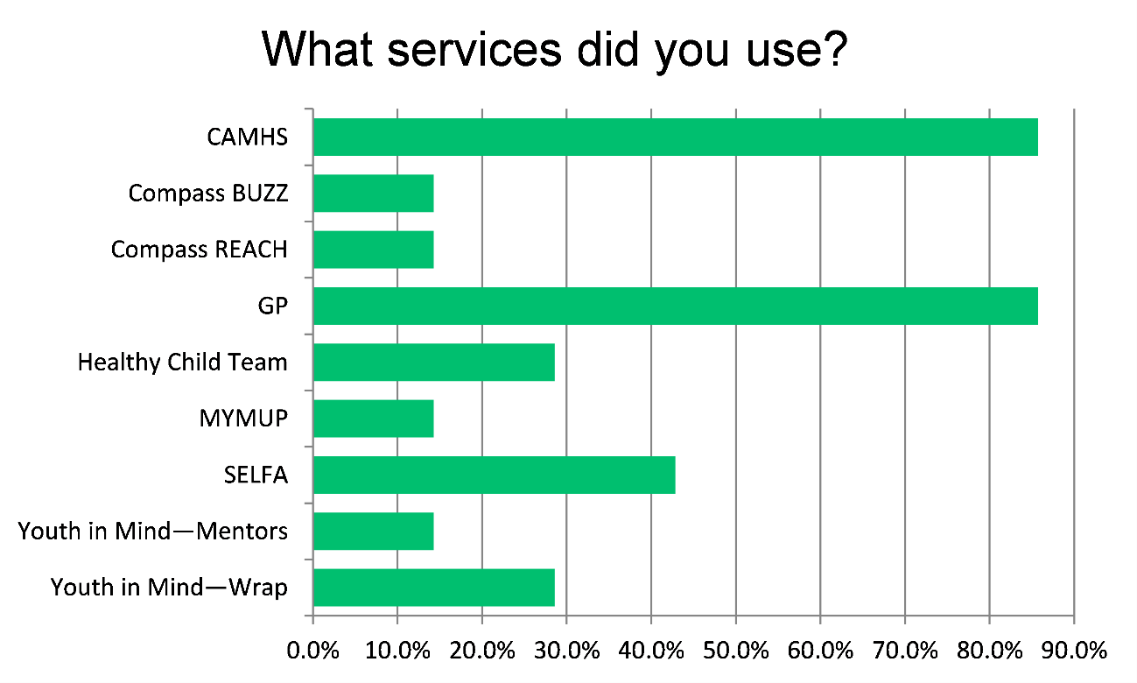

Slide 13
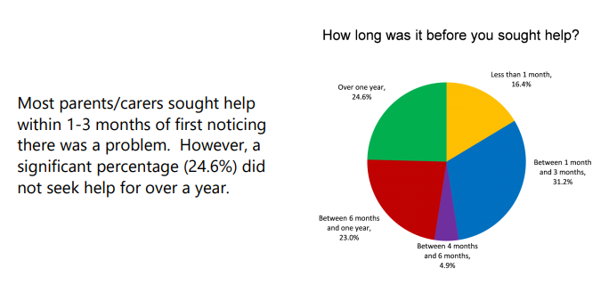

Slide 14
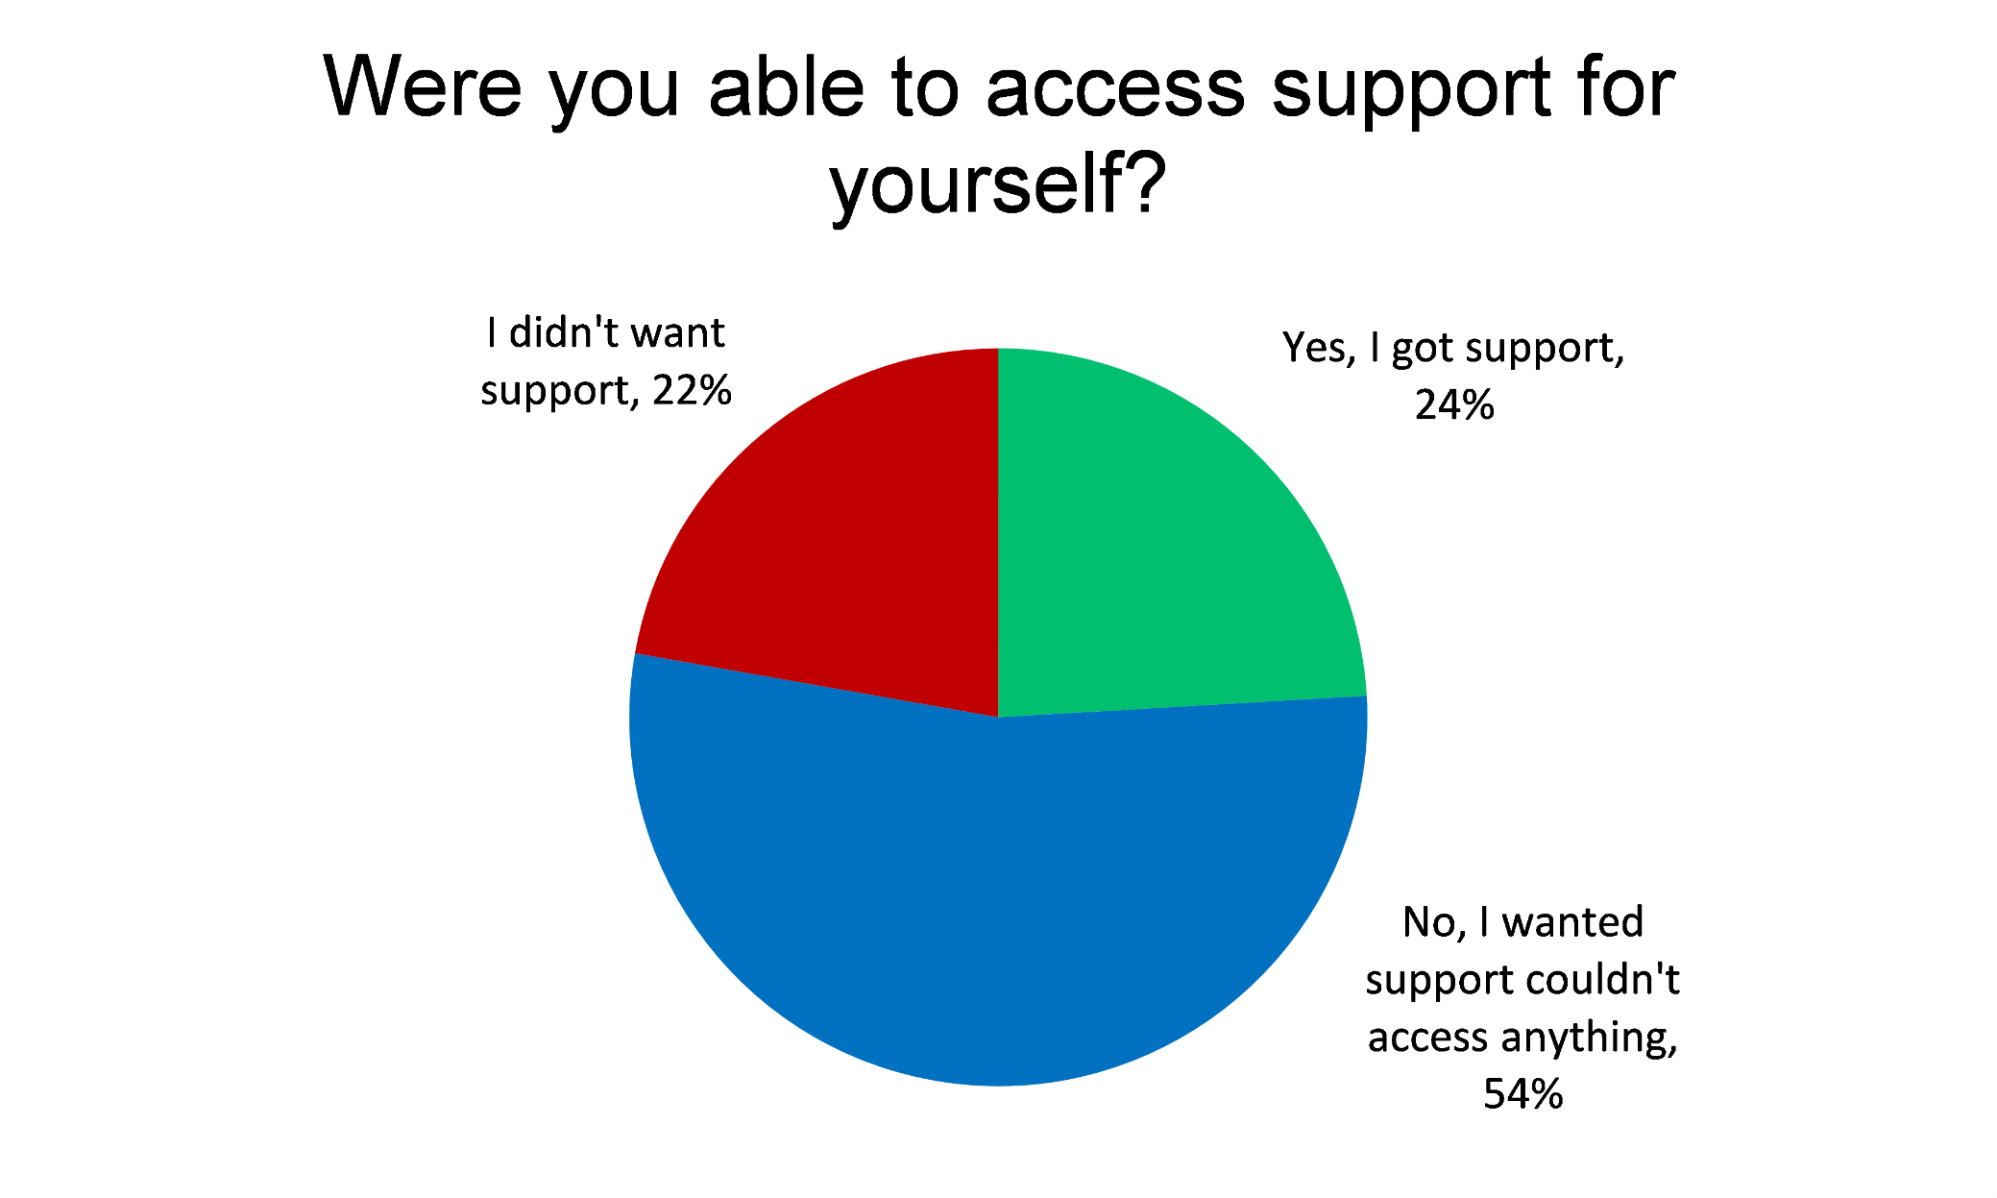

Slide 15
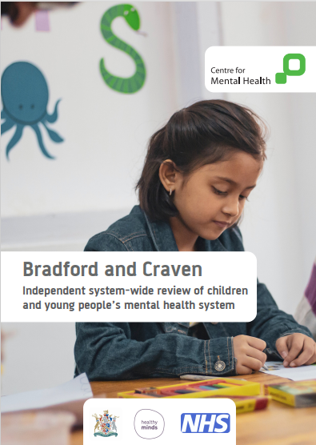

Slide 16
Emotional Wellbeing Group (EWB)
Impact of COVID-19 on children and young people
Trends during Covid-19:
Lack of support for parents of children with SEND
Impact on young carers
Gaming related issues
Aggression within the home environment towards parents & siblings
Sleep deprivation/ lack of sleep routine
Impact of lockdown on children and young people with Autism

Slide 17
Emotional Wellbeing Group (EWB)
Next Steps
Work together to address the following issues:
Continue collaborative working across Craven
Support for parents of children experiencing mental health issues
A Pathway for parents, to help them navigate services
Crisis support where children and young people live
Early support for children and young people during and post Covid-19

