Slide 1

Adults Social Prescribing Service
- Open to Patients 18+ years old
Clinics currently running over the phone / video call.
Examples of referrals include:
Bereavement Support
Loneliness & isolation
Financial & Employment Support
Housing Advice
Learn a new skill / hobby or access an adult educational course
Access therapy
Volunteer placements
Access Home Help
Access to exercise & weight management programmes
Access Peer Support Groups or Community / Voluntary Service
Social Prescribing Service
Empowering Patients with the knowledge and skills to help manage their own health & wellbeing to the best of their ability

Slide 2

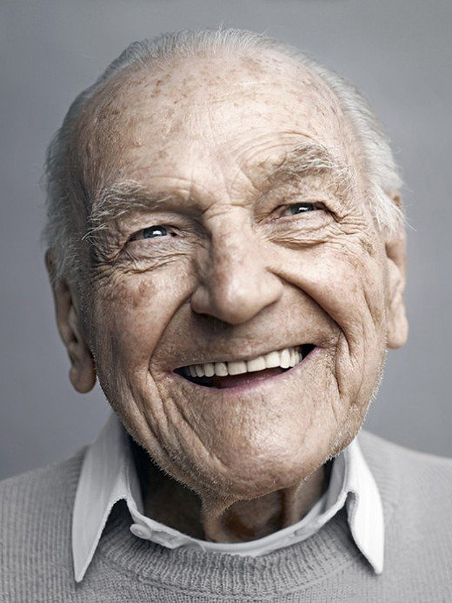
Adults Social Prescribing Service
Open to 18+ year olds
Appointments online or telephone based
Accepting referrals on Compass – e Hub
Support with :
Behaviour & lifestyle changes
Improving management of long term condition(s)
Social Support
Bereavement Support
Improving mental wellbeing
Connecting to sport, social or education based group
Access to Financial & Employment Support
Access to Housing Advice
Access to Carer Support
Case Study
John *
Early onset dementia
Lives with wife (main carer)
Low mood , isolated
Worth Connecting
Online Dancing Group
Attendance Allowance
Dementia information and advice
Regular reviews

Slide 3

Children’s SP Service
(GR8 MINDS)
Open to 3-18 years old’s
Appointments in colleges , Schools, Youth Clubs & via videocall
Support with :
Mental wellbeing
Improving engagement with school / children’s services
Supporting Families to access the right local services/ groups / charities
Social Support
Supporting health and lifestyle behavior changes
Support Patients making transitions through difficult life changing events such as parents divorcing

Slide 4
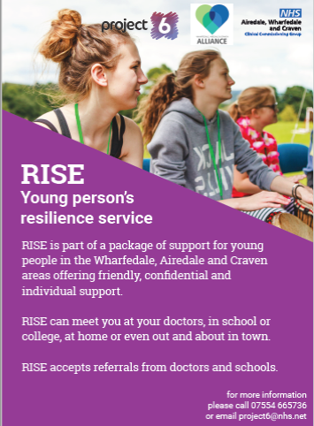
Children’s Counselling Service
(GR8 MINDS)
Appointments available on video call and in Schools
Cognitive Behaviour Therapy
Emotional Resilience Training
Motivational Interviewing
Supports children to improve self esteem, low mood & anxiety

Slide 5
Response to COVID 19
Rapid changes to service, adopting remote working
Supporting clinicians with care plans for most vulnerable shielding patients.
Recruitment of medical students – welfare calls
Moved social and peer support groups online (or dial in)
Renewed focus on partnership working
Work to address issues around digital exclusion
Supported community response hubs
Supported Staff Wellbeing
We had the skills experience , networks and practical support to be able to quickly support those most in need.
Notes:
Embracing a renewed focus on partnership working, so that people in Craven got the support they need, at what ever stage they need it.
We made some rapid changes to the service , adopting a remote telephone and video call service & supported clinicians set up care plans for the most vulnerable shielding patients.
We recruited a team of medical students to support with welfare calls to Patients over the age of 70 . Full training and supervision was completed.
We stopped all of our social and peer support groups, and replaced this with an online (or dial in) offer.
We are working with the Patient Participation Group to help address the barriers patients face with accessing primary care through technology.
We supported community response hubs with training and partnership opportunities, so they could develop to help meet the demands.
We had the skills experience , networks and practical support to be able to quickly support those most in need.

Slide 6
Change of Needs
Start of lockdown, focused on supporting with immediate welfare needs:
  practical or social care support
  dealing with financial challenges
  domestic abuse
  food parcels
More recently , referral trends show more people needing support with :
  coping with depression and anxiety
  getting people back into work
  combatting loneliness
  Support to get online
  Access to alcohol & substance misuse support.
  Access to self help resources and peer support
We are still using all of our tools and skills to do this; connecting people, building relationships, letting people talk about what they need and want right now.
Notes:
At the start of lockdown, we were focused on supporting people short term with immediate welfare needs such as setting up practical or social care support, dealing with financial challenges, domestic abuse and food parcels.
As the months progressed, we are now supporting people coping with depression and anxiety, getting people back into work, combatting loneliness and supporting people to access self help resources and peer support.
We are still using all of our tools and skills to do this; connecting people, building relationships, letting people talk about what they need and want right now.

Slide 7
Key Craven Partners for Mental Wellbeing
Pioneer Projects
My Wellbeing College
Peer Talk
Age UK North Craven
Age UK South Craven
Skipton Step into Action
Living Well (NYCC)
Champions Show the Way
Adult Skills and Learning (NYCC)
SELFA
Settle Hub
Compass
Relate
Cruse Bereavement
First Response
24 hour crisis help line
01274 221181

Slide 8

Online Mental Health Support
QWELL – adult counselling
KOOTH – children’s counselling
Headspace
Buzz – Compass text service
MIND
GR8 MINDS

Slide 9
Craven Team Contacts
GP Practice | Social Prescriber (Adults Team)
Townhead Surgery | Emma Taylor emma.taylor42@nhs.net
Dyneley House Surgery | Emma Taylor & Mel Blott melanie.blott@bradford.nhs.uk
Grassington Medical Centre | Mel Blott
Addingham Medical Centre | Sue Moorchild sue.moorchild@bradford.nhs.uk
Fisher Medical Centre | Simon Booth *Modality
Cross Hills Medical Centre | Simon Booth *Modality
Children’s Team (3-18 year olds) *only available at WACA GP practices
Counsellor | Hilary Bailey hilary.bailey@project6.org.uk
Social Prescriber | David Pugh David.pugh5@nhs.net

